Slide 2
Modern Climate Change: A Symptom of Humanity’s Evolution into a Growth-Addicted Industrialized Civilization
Ubuntu:
“I am, because of you”
“a person is a person through other persons”
Me:
“I know, because of you”
Hans-Peter Plag
Old Dominion University
Norfolk, VA, USA

Slide 3
Modern Climate Change: A Symptom of Humanity’s Evolution into a Growth-Addicted Industrialized Civilization
Our perception depends on the distance we have …
Hans-Peter Plag
Old Dominion University
Norfolk, VA, USA

Slide 5
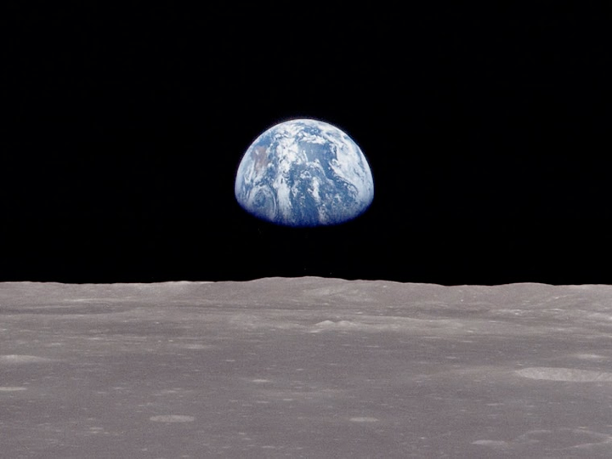
Life-Support System: Physiology
Homeostasis
Global Essential Variable: Energy Imbalance: Incoming energy - Outgoing energy

Slide 6
Planetary Life-Support System
Physiology: Homeostasis
Essential: Earth’s Energy Imbalance: Incoming Energy - Outgoing Energy
“Healthy Life-Support System”: Energy Imbalance is very small, tiny
10⁻¹⁰ to 10⁻⁹
Earth’s energy imbalance due to photosynthesis: on the order of 10⁻¹⁰ to 10⁻⁹
Imbalance today: on the order of 10⁻³ (300-320 TeraWatt),
(e.g., Stephens et al., 2012; Trenberth et al., 2014, Cheng et al., 2016)
10⁻³
(1) Where is the additional energy stored and what are the impacts?
(2) Why did the imbalance increased?

Slide 7
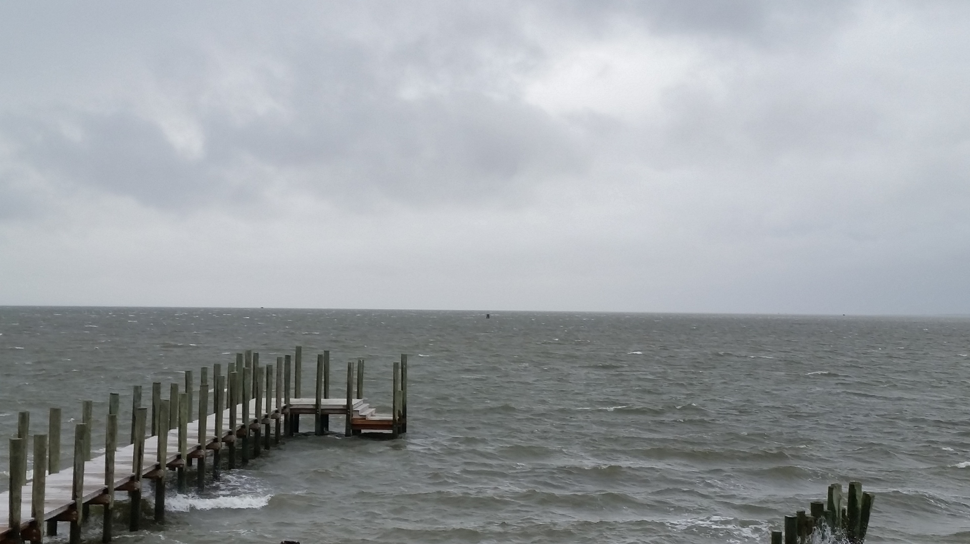
Modern Climate Change: A Symptom of Humanity’s Evolution into a Growth-Addicted Industrialized Civilization
Contents
The Baseline: Past Climate Changes
The Syndrome: Recent Climate and Global Change
The Diagnosis: Leaving the “Safe Operating Space”
The Prognosis: Journey Into the Unknown
The Therapy: “Lifestyle” changes
Hans-Peter Plag
February 9, 2016

Slide 8
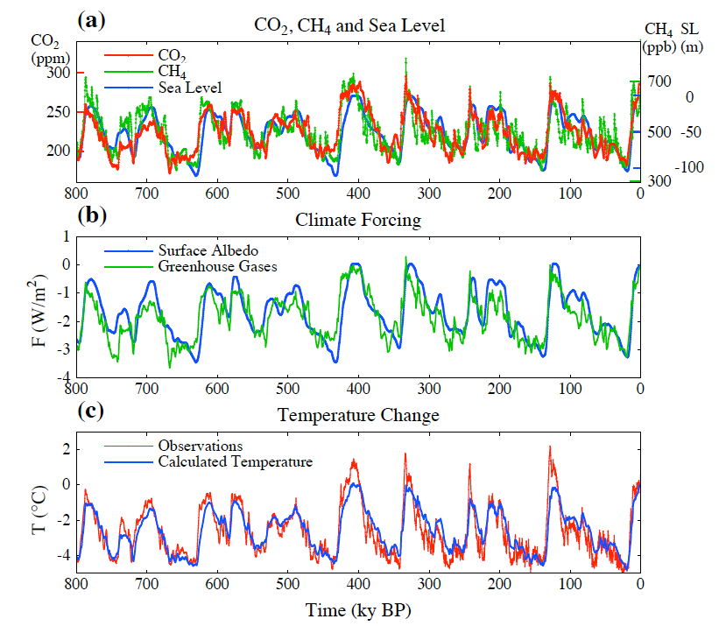
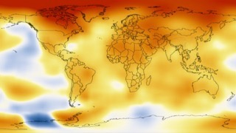
The Baseline: Past Climate and Global Change
Climate Change is a long-term shift in the statistics of weather - averages, frequency and magnitude of extremes.
Climate is determined by:
incoming radiation (sun)
reflected radiation (albedo)
retained heat (Greenhouse gases)
Warm period
“Inter-glacial”
Cold period
Ice age
“glacial”
Climate can change from local to global scales.
Temperature anomaly 2008-2012 compared to 1900
Climate can change a lot over time.
Temperature difference:
4ºC - 5ºC

Slide 9
The Baseline: Past Climate and Global Change

Slide 10
The Baseline: Past Climate and Global Change
Popular Mechanics, March 1912, 393-342
“It is largely the courageous, enterprising, and ingenious American whose brains are changing the world. Yet even the dull foreigner, who burrows in the earth by the faint gleam of his miner's lamp, not only supports his family and helps to feed the consuming furnaces of modern industry, but by his toil in the dirt and darkness adds to the carbon dioxide in the earth's atmosphere so that men in generations to come shall enjoy milder breezes and live under sunnier skies.”

Slide 11
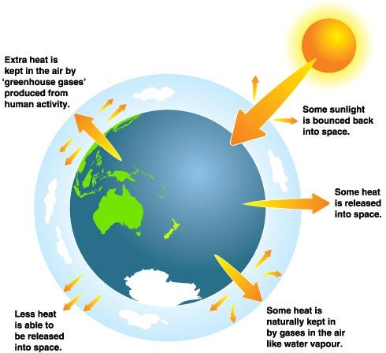
The Baseline: Past Climate and Global Change
Earth's energy imbalance is the difference between the amount of solar energy absorbed by Earth and the amount of energy the planet radiates to space as heat.
Earth’s Energy Imbalance: EI = Solar irradiance - Released Energy
With increasing Greenhouse gases, more heat is stored in atmosphere
EI > 0: Global Warming
EI < 0: Global Cooling
Some sunlight is bounced back into space
What can change?
Solar irradiance can change
Currently: 1366±1 W/m² (~240 W/m²)
Reflected radiation can change (albedo)
Absorbed energy can change
Some solar energy is used by plants and stored in fossils fuels
Some heat is released into space
Longterm EI: 0.0000001-0.0000003 W/m²
10,000 years EI: ±0.01 W/m²
Current EI: ~0.6 W/m²
Some heat is absorbed by Greenhouse gases (CO2, CH4, H2O, ...)
Less heat is released to space and stored in ocean and hydrosphere

Slide 12
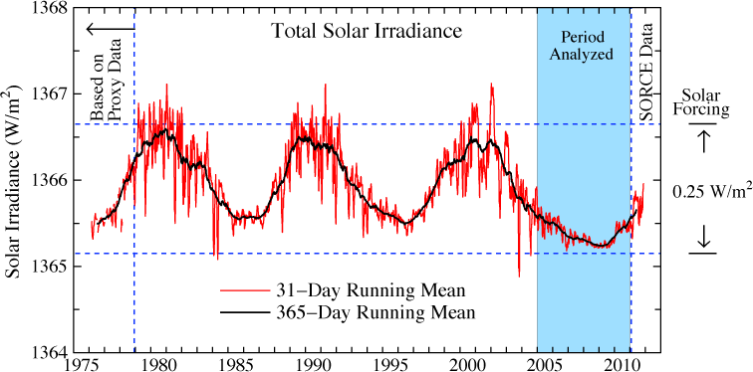
The Baseline: Past Climate and Global Change
Solar irradiance in the era of accurate satellite data. Left scale is the energy passing through an area perpendicular to Sun-Earth line. Averaged over Earth's surface the absorbed solar energy is ~240 W/m², so the amplitude of solar variability is a forcing of ~0.25 W/m². (Credit: NASA/GISS)

Slide 13
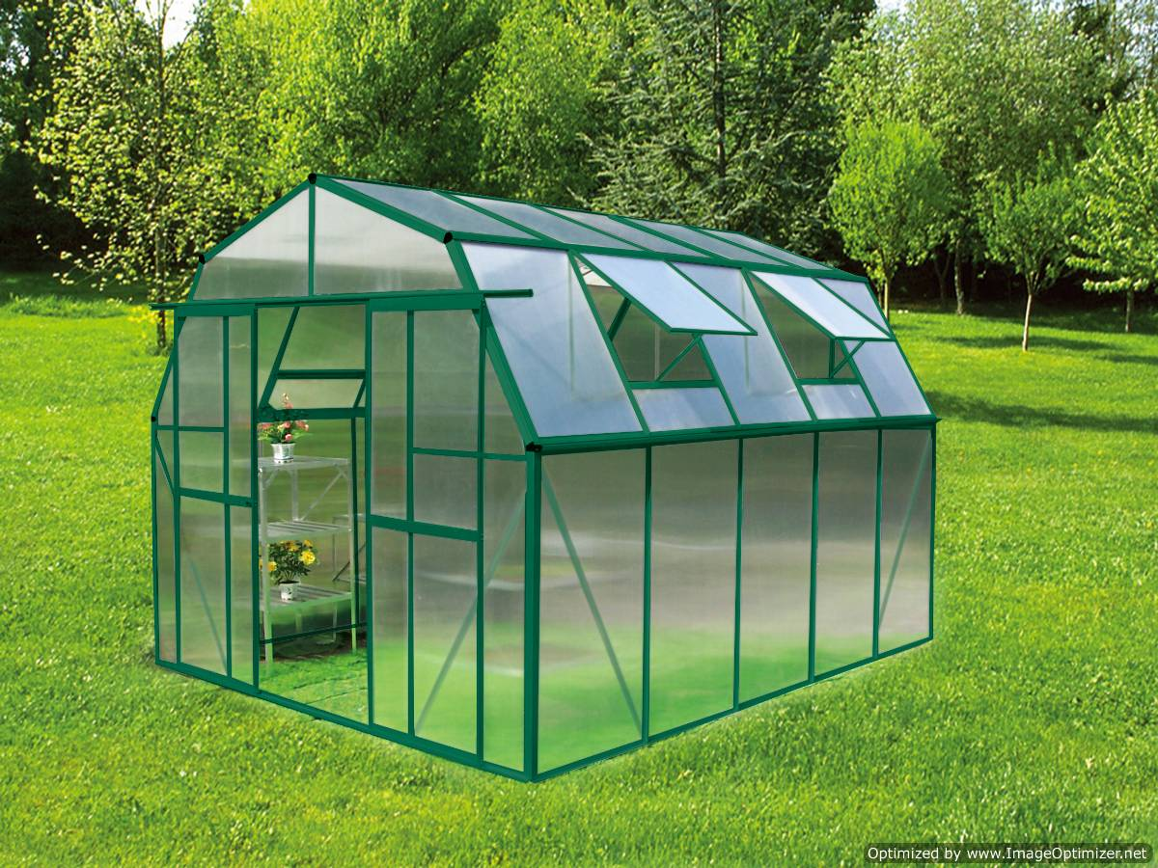
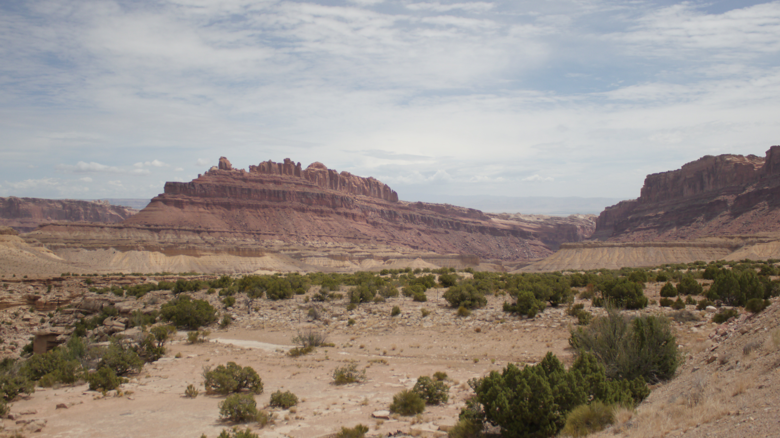
The Baseline: Past Climate and Global Change
Greenhouse
Poolhouse
Volumetric heat capacity of water compared to air: About 3300 time higher

Slide 14
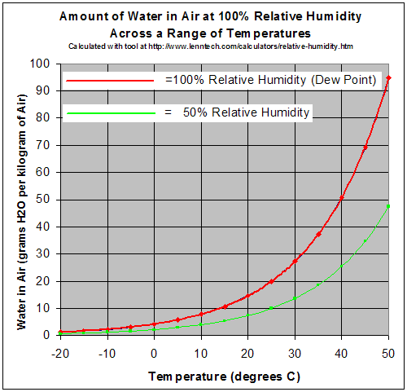
The Baseline: Past Climate and Global Change
Specific heat capacity:
Water: 4200 Jkg⁻¹K⁻¹
Air: 993 Jkg⁻¹K⁻¹
Water has 4.23 times higher specific heat capacity.
Density:
Water: 1000 kg/m³
Air: 1.275 kg/m³
Water is about 785 times denser than air.
Volumetric heat capacity:
Water compared to air:
About 3300 time higher volumetric heat capacity

Slide 15
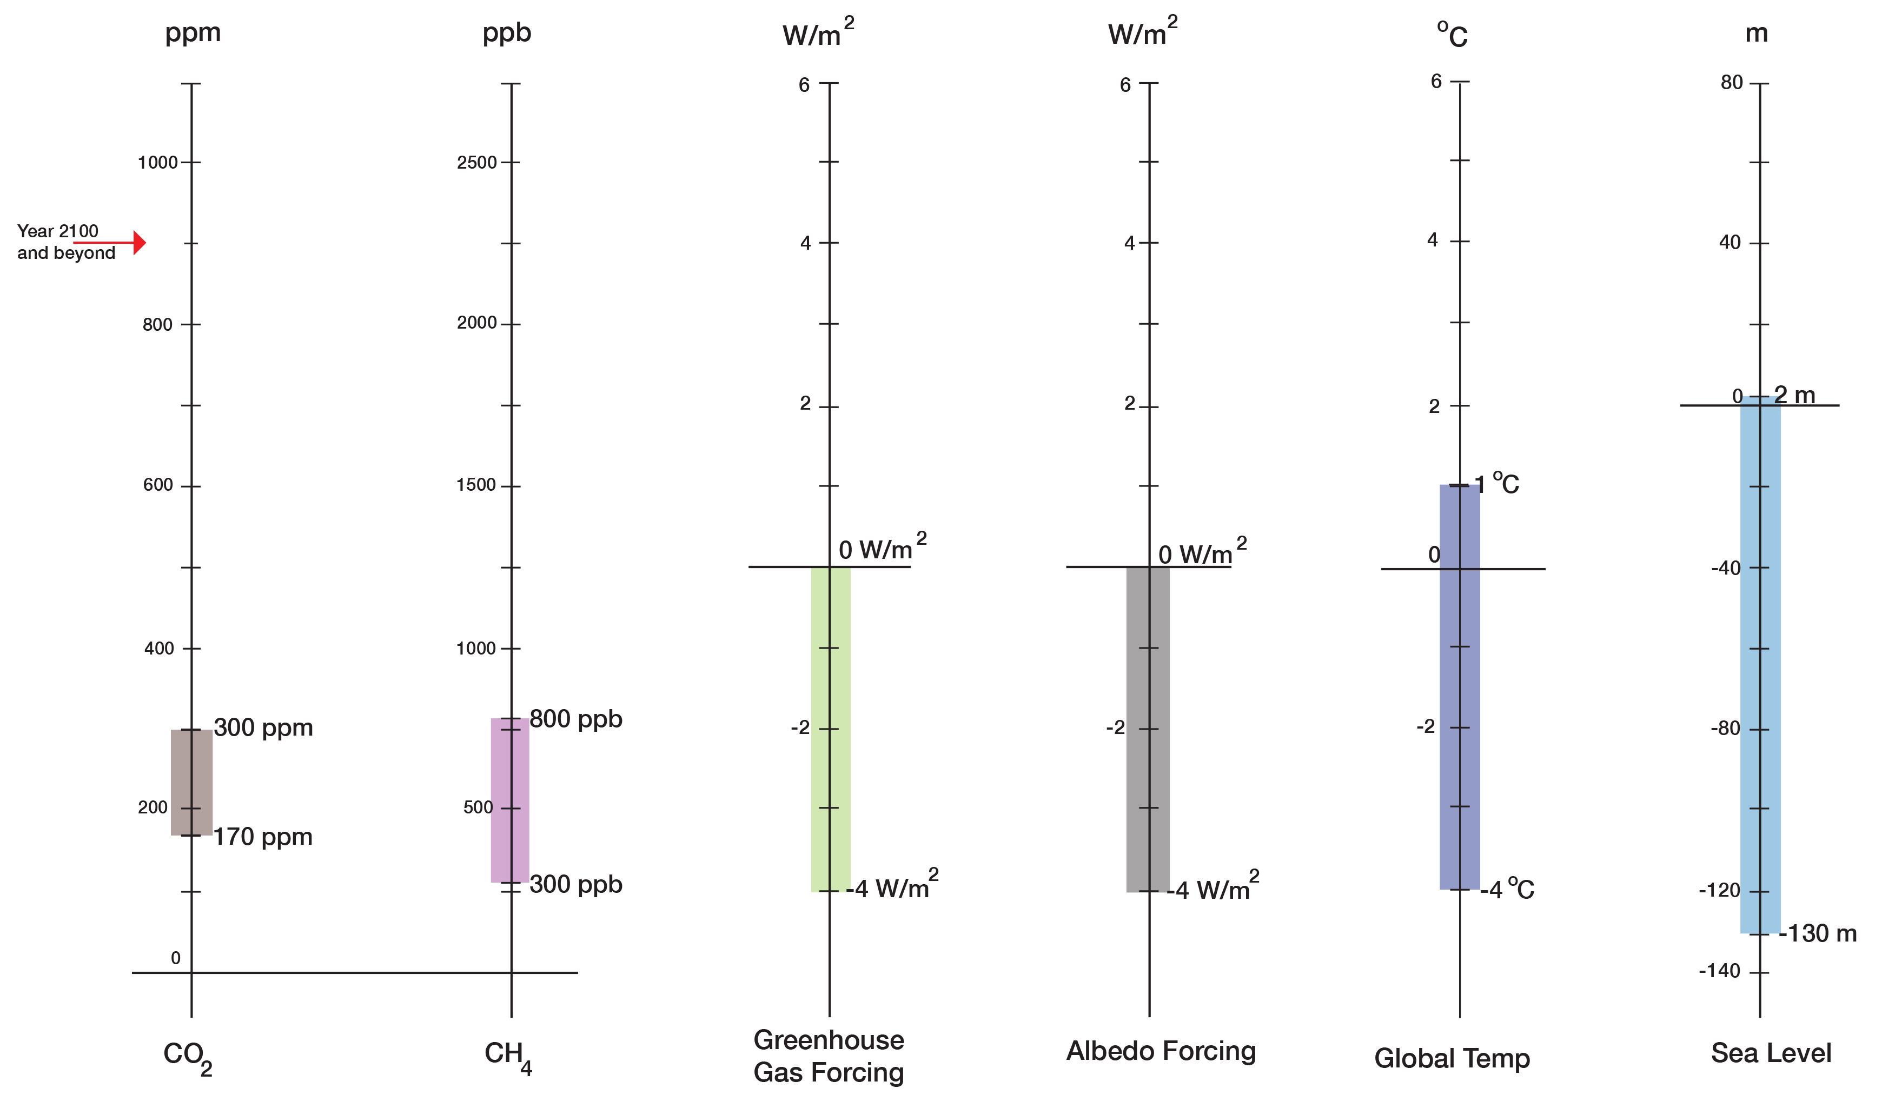
The Baseline: Past Climate and Global Change
Long-term (centuries to millennia) correlations:
130 ppm CO2 <=> 5ºC
130 ppm CO2 <=> 130 m in sea level
Medical Lab Sheet
Normal Range up to 1900
(800,000 yrs)
Holocene

Slide 16
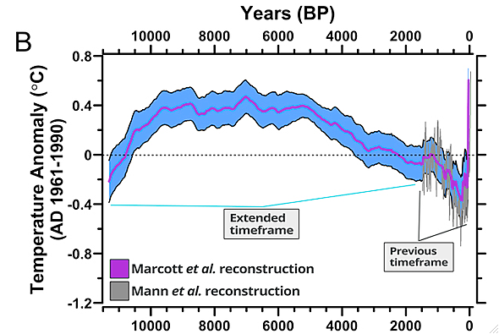
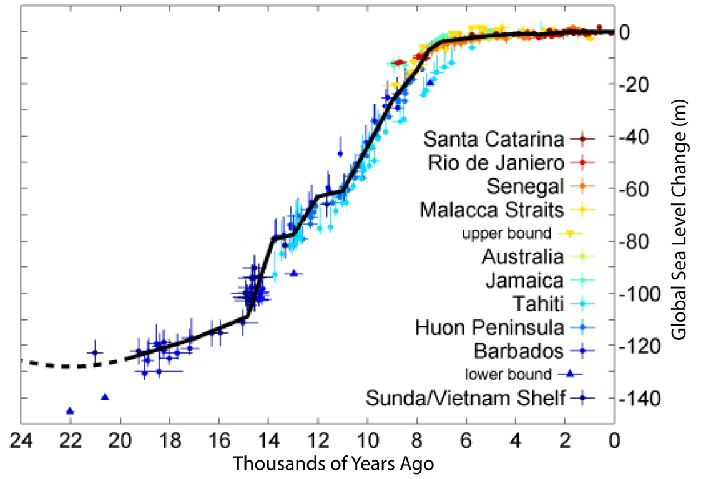
The Baseline: Past Climate and Global Change
Normalcy Bias: Climate variations are small and sea level is stable
Global Temperature Changes
Global Sea Level Changes
Settlements in river deltas
<--Holocene-->
<------------Holocene------------>
Marcott et al., 2013
With stable climate and sea level, the Holocene was a safe operating space for humanity.

Slide 17
Key Points
Baseline
During the Holocene, climate and sea level were exceptionally stable
The Holocene was a “safe operating space for humanity”

Slide 18
Modern Climate Change: A Symptom of Humanity’s Evolution into a Growth-Addicted Industrialized Civilization
Contents
The Baseline: Past Climate Changes
The Syndrome: Recent Climate and Global Change
The Diagnosis: Leaving the “Safe Operating Space”
The Prognosis: Journey Into the Unknown
The Therapy: “Lifestyle” changes
Hans-Peter Plag
February 9, 2016

Slide 19
The Syndrome: Recent Climate and Global Change
Temperature 2008-2012 compared to 1900

Slide 20
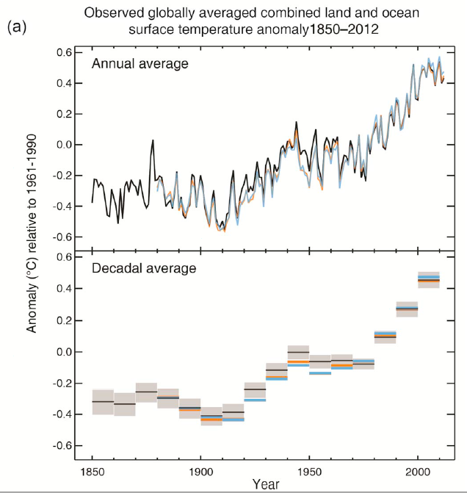
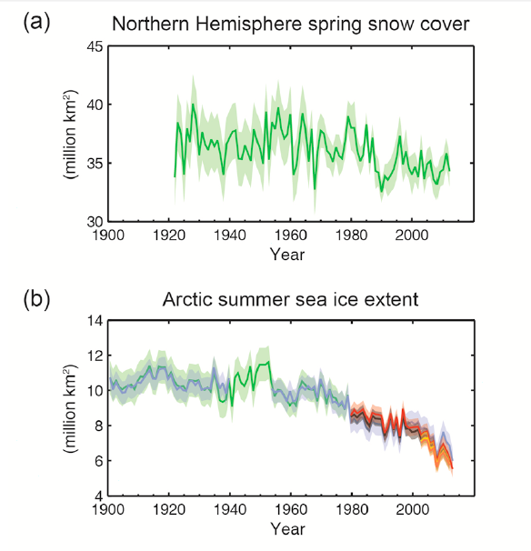
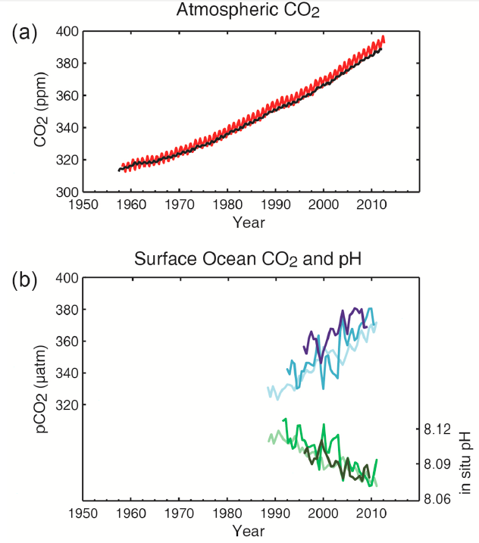
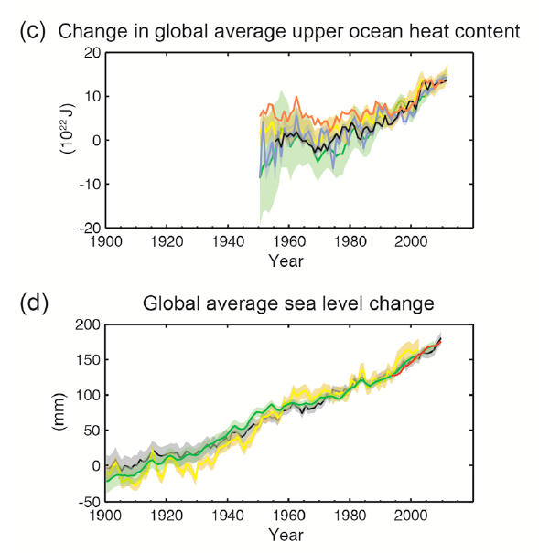
The Syndrome: Recent Climate and Global Change
Snow Cover
Temperature
Sea Ice
Upper Ocean Heat
Sea Level
IPCC, 2013

Slide 21
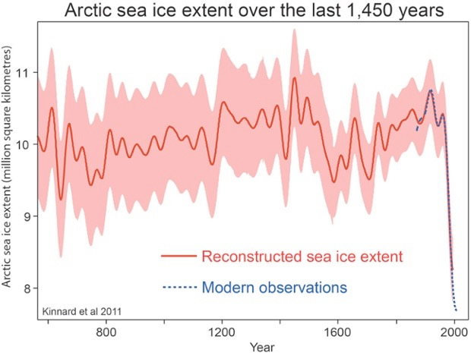
The Syndrome: Recent Climate and Global Change
Marcott et al., 2013
Kinnart et al., 2011

Slide 22
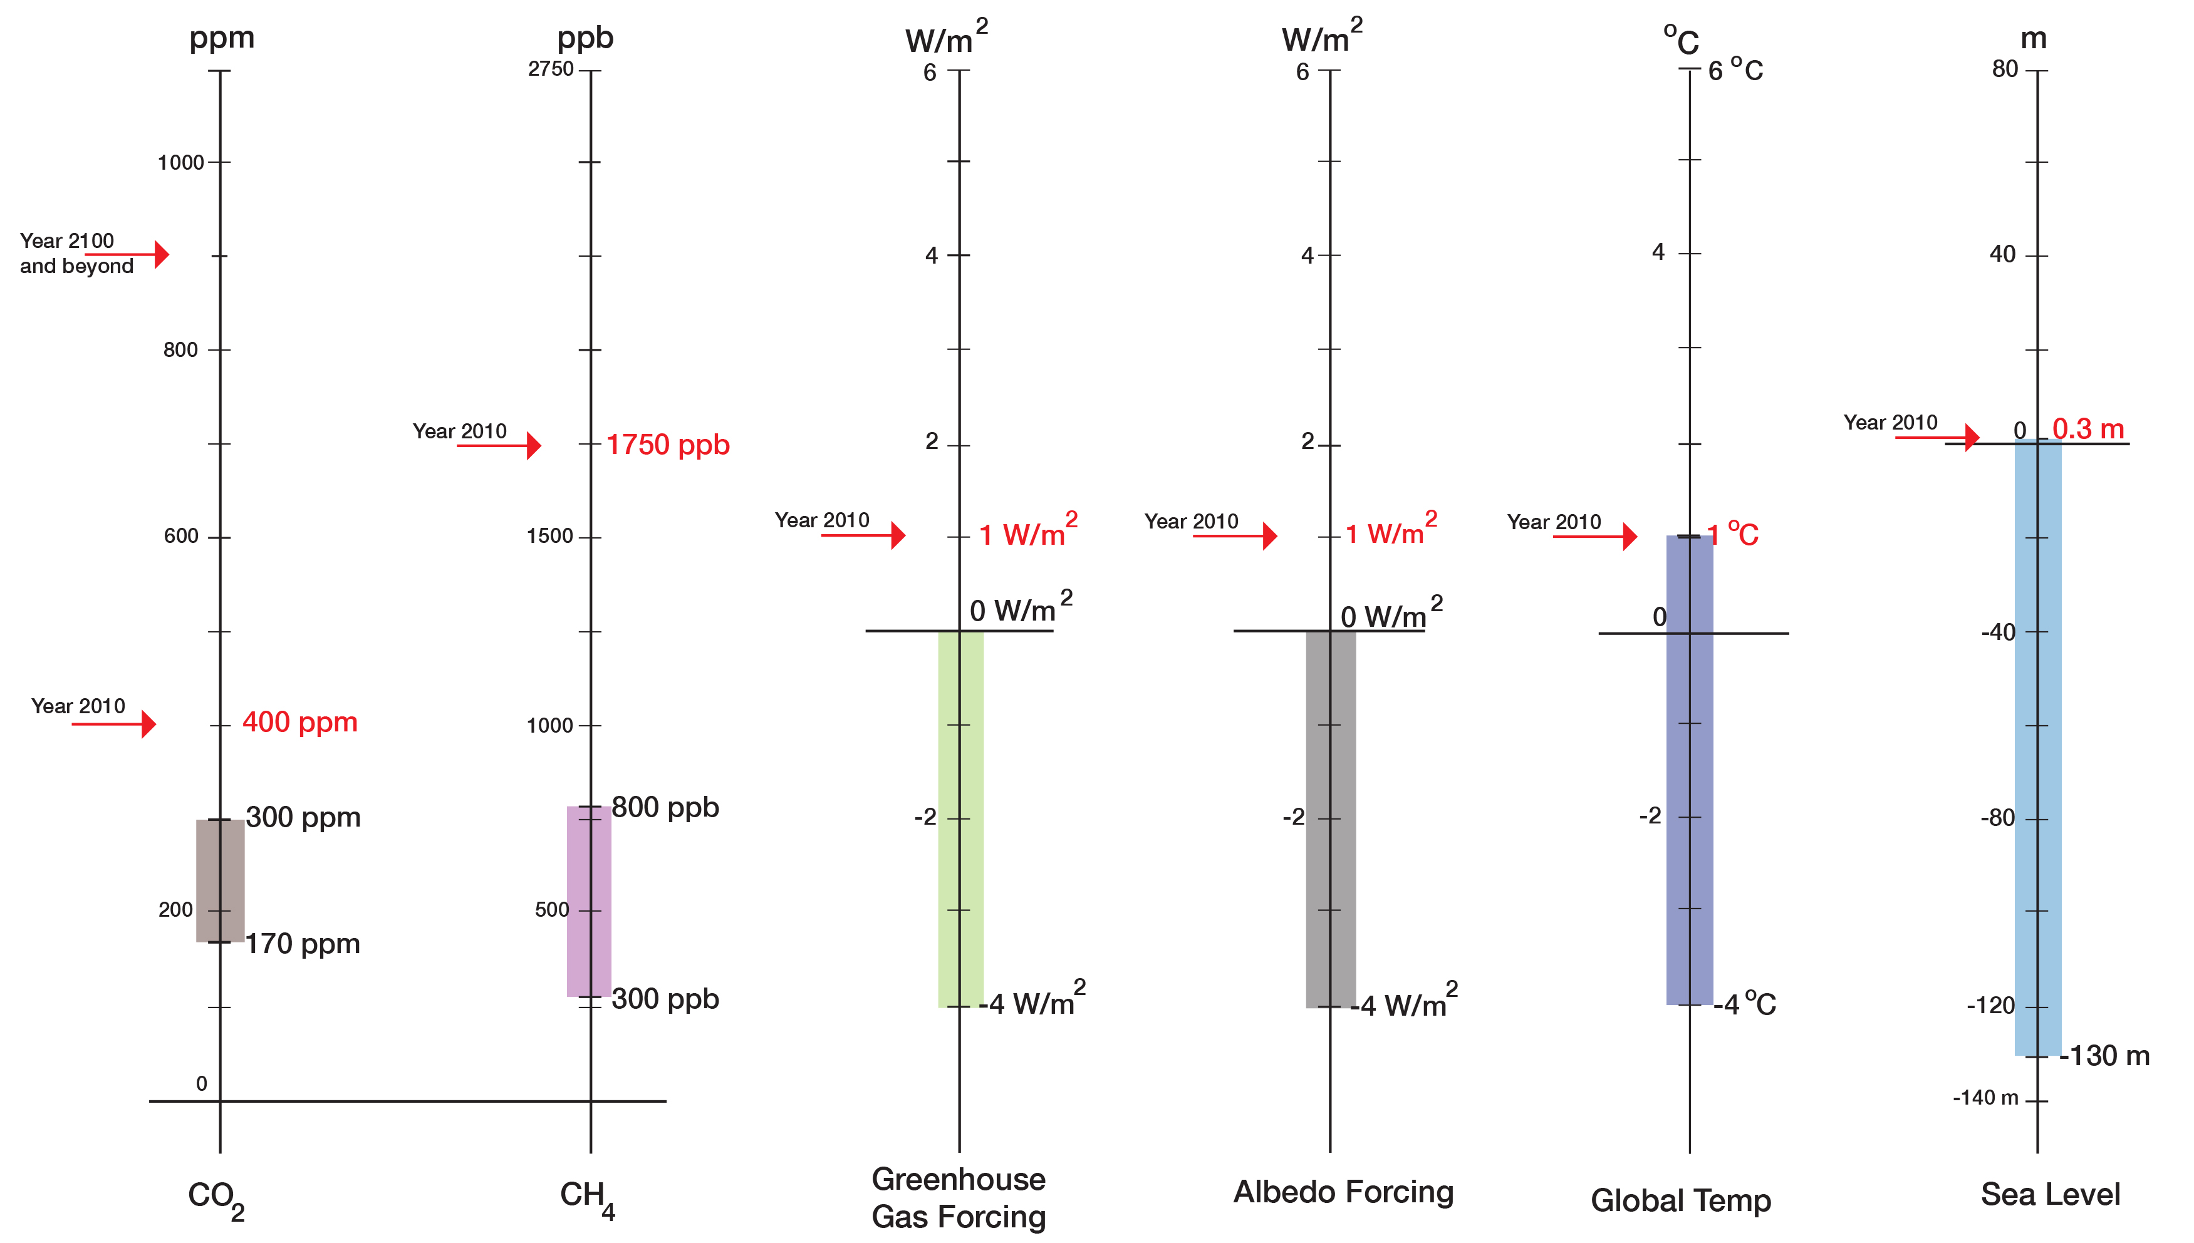
The Syndrome: Recent Climate and Global Change
The Lab Results for “Patient Earth”
“Current State”
“Normal Range”
(800,000 years)

Slide 23
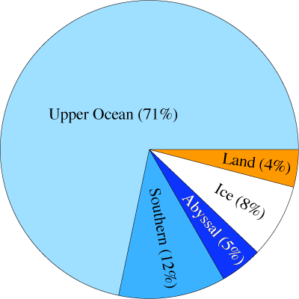
The Syndrome: Recent Climate and Global Change
Earth’s Energy Imbalance
10⁻¹⁰ to 10⁻⁹
Long-term due to photosynthesis: 10-100 MegaWatt
Today: 300-320 TeraWatt
10⁻³
The Earth system is storing far more heat (energy) than what the rising air temperature indicates
The Pool-House Effect

Slide 24
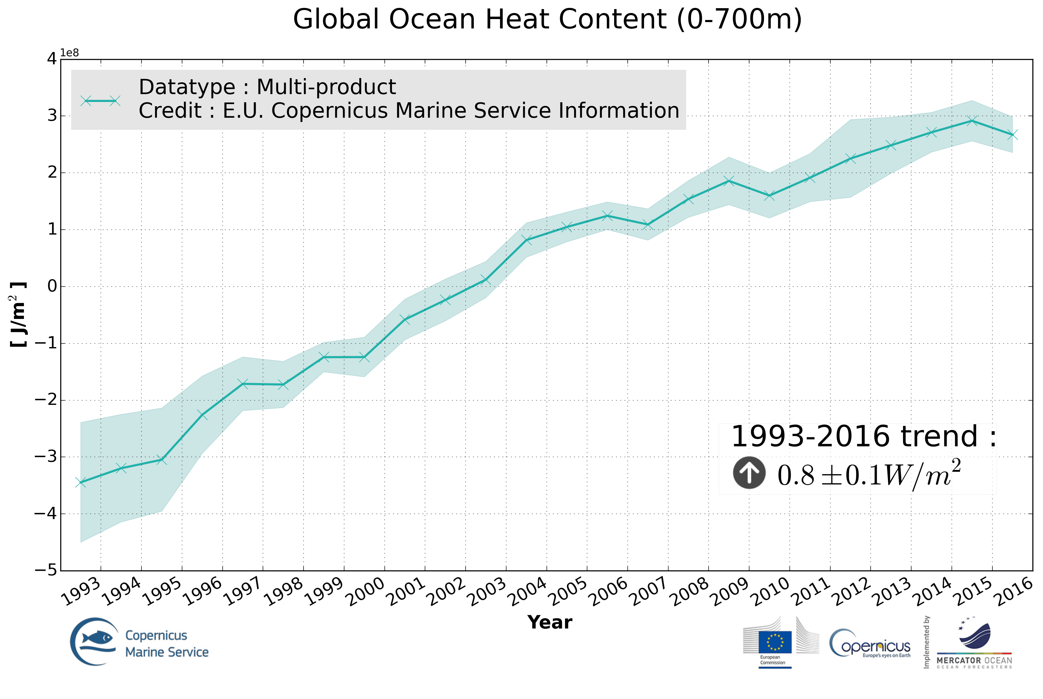
The Syndrome: Recent Climate and Global Change

Slide 25
The Syndrome: Recent Climate and Global Change
Earth’s Energy Imbalance
What increased the Earth’s energy imbalance by a factor of 10⁶ to 10⁷?
10⁻¹⁰-10⁻⁹
Incoming
Solar
3x10⁻³
Incoming
Solar
Outgoing Radiation
Outgoing Radiation
Storage in fossil fuels
Storage in heat
Imbalance on the order of 10⁻¹⁰-10⁻⁹
Imbalance on the order of 3x10⁻³
Last 70 years
Last 200 Million years
Total energy storage in 200 Myrs:
Order 100-1000 ZetaJoules
Total energy storage per century:
Order 1000 ZetaJoules

Slide 26
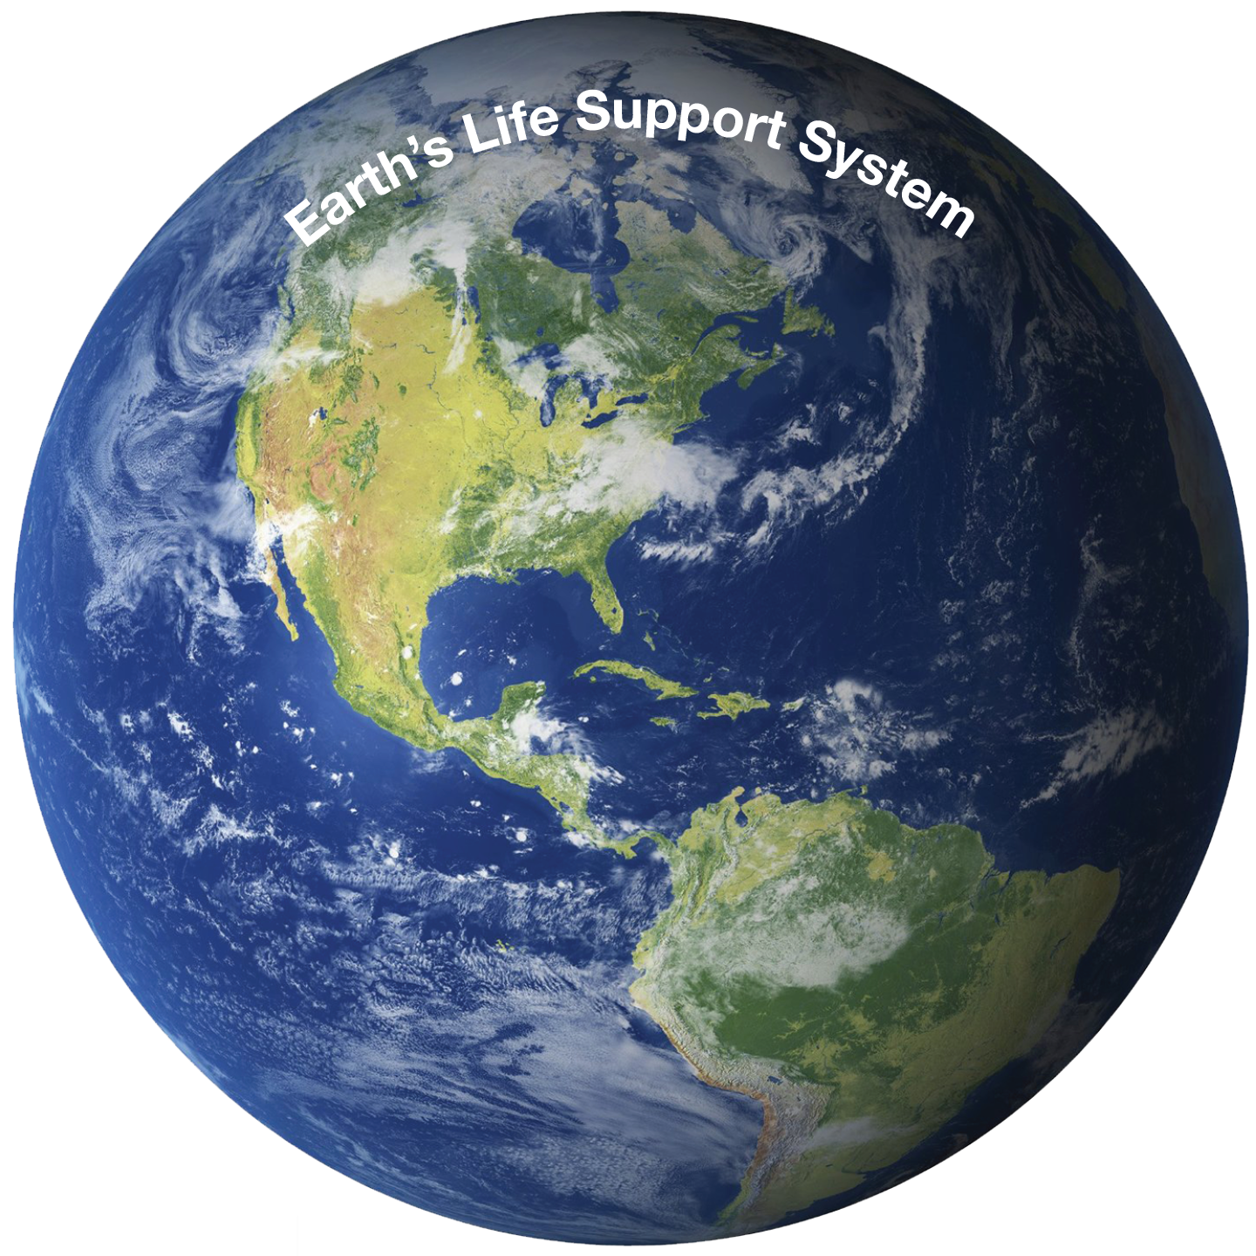
The Syndrome: Recent Climate and Global Change
Planetary Physiology
Flows in the Earth System also allow assessing the “Health of the Planet”
FLOWS
Earth: Life-Support System for many species
Everything is about Flows
Limitations in the flows between a community and its life-support system limit the growth of the community
For Home sapiens, the flows are regulated by ethical, social, and - recently - economic rules

Slide 27
The Syndrome: Recent Climate and Global Change
Planetary Physiology
Flows in the Earth System also allow assessing the “Health of the Planet”
FLOWS
Earth: Life-Support System for many species
Everything is about Flows
Flows have accelerated in the last 200 years

Slide 28
Key Points
Baseline
During the Holocene, climate and sea level were exceptionally stable
The Holocene was a “safe operating space for humanity”
Syndrome
During the last few hundred years, humanity has introduced rapid and large changes
The system is outside the “normal range” and in the dynamic transition into the Post-Holocene; we have increasing disequilibrium

Slide 29
Modern Climate Change: A Symptom of Humanity’s Evolution into a Growth-Addicted Industrialized Civilization
Contents
The Baseline: Past Climate Changes
The Syndrome: Recent Climate and Global Change
The Diagnosis: Leaving the “Safe Operating Space”
The Prognosis: Journey Into the Unknown
The Therapy: “Lifestyle” changes
Hans-Peter Plag
February 9, 2016

Slide 30
The Diagnosis: Leaving the “Safe Operating Space”
https://www.theguardian.com/environment/2017/feb/12/humans-causing-climate-to-change-170-times-faster-than-natural-forces?CMP=share_btn_tw

Slide 31
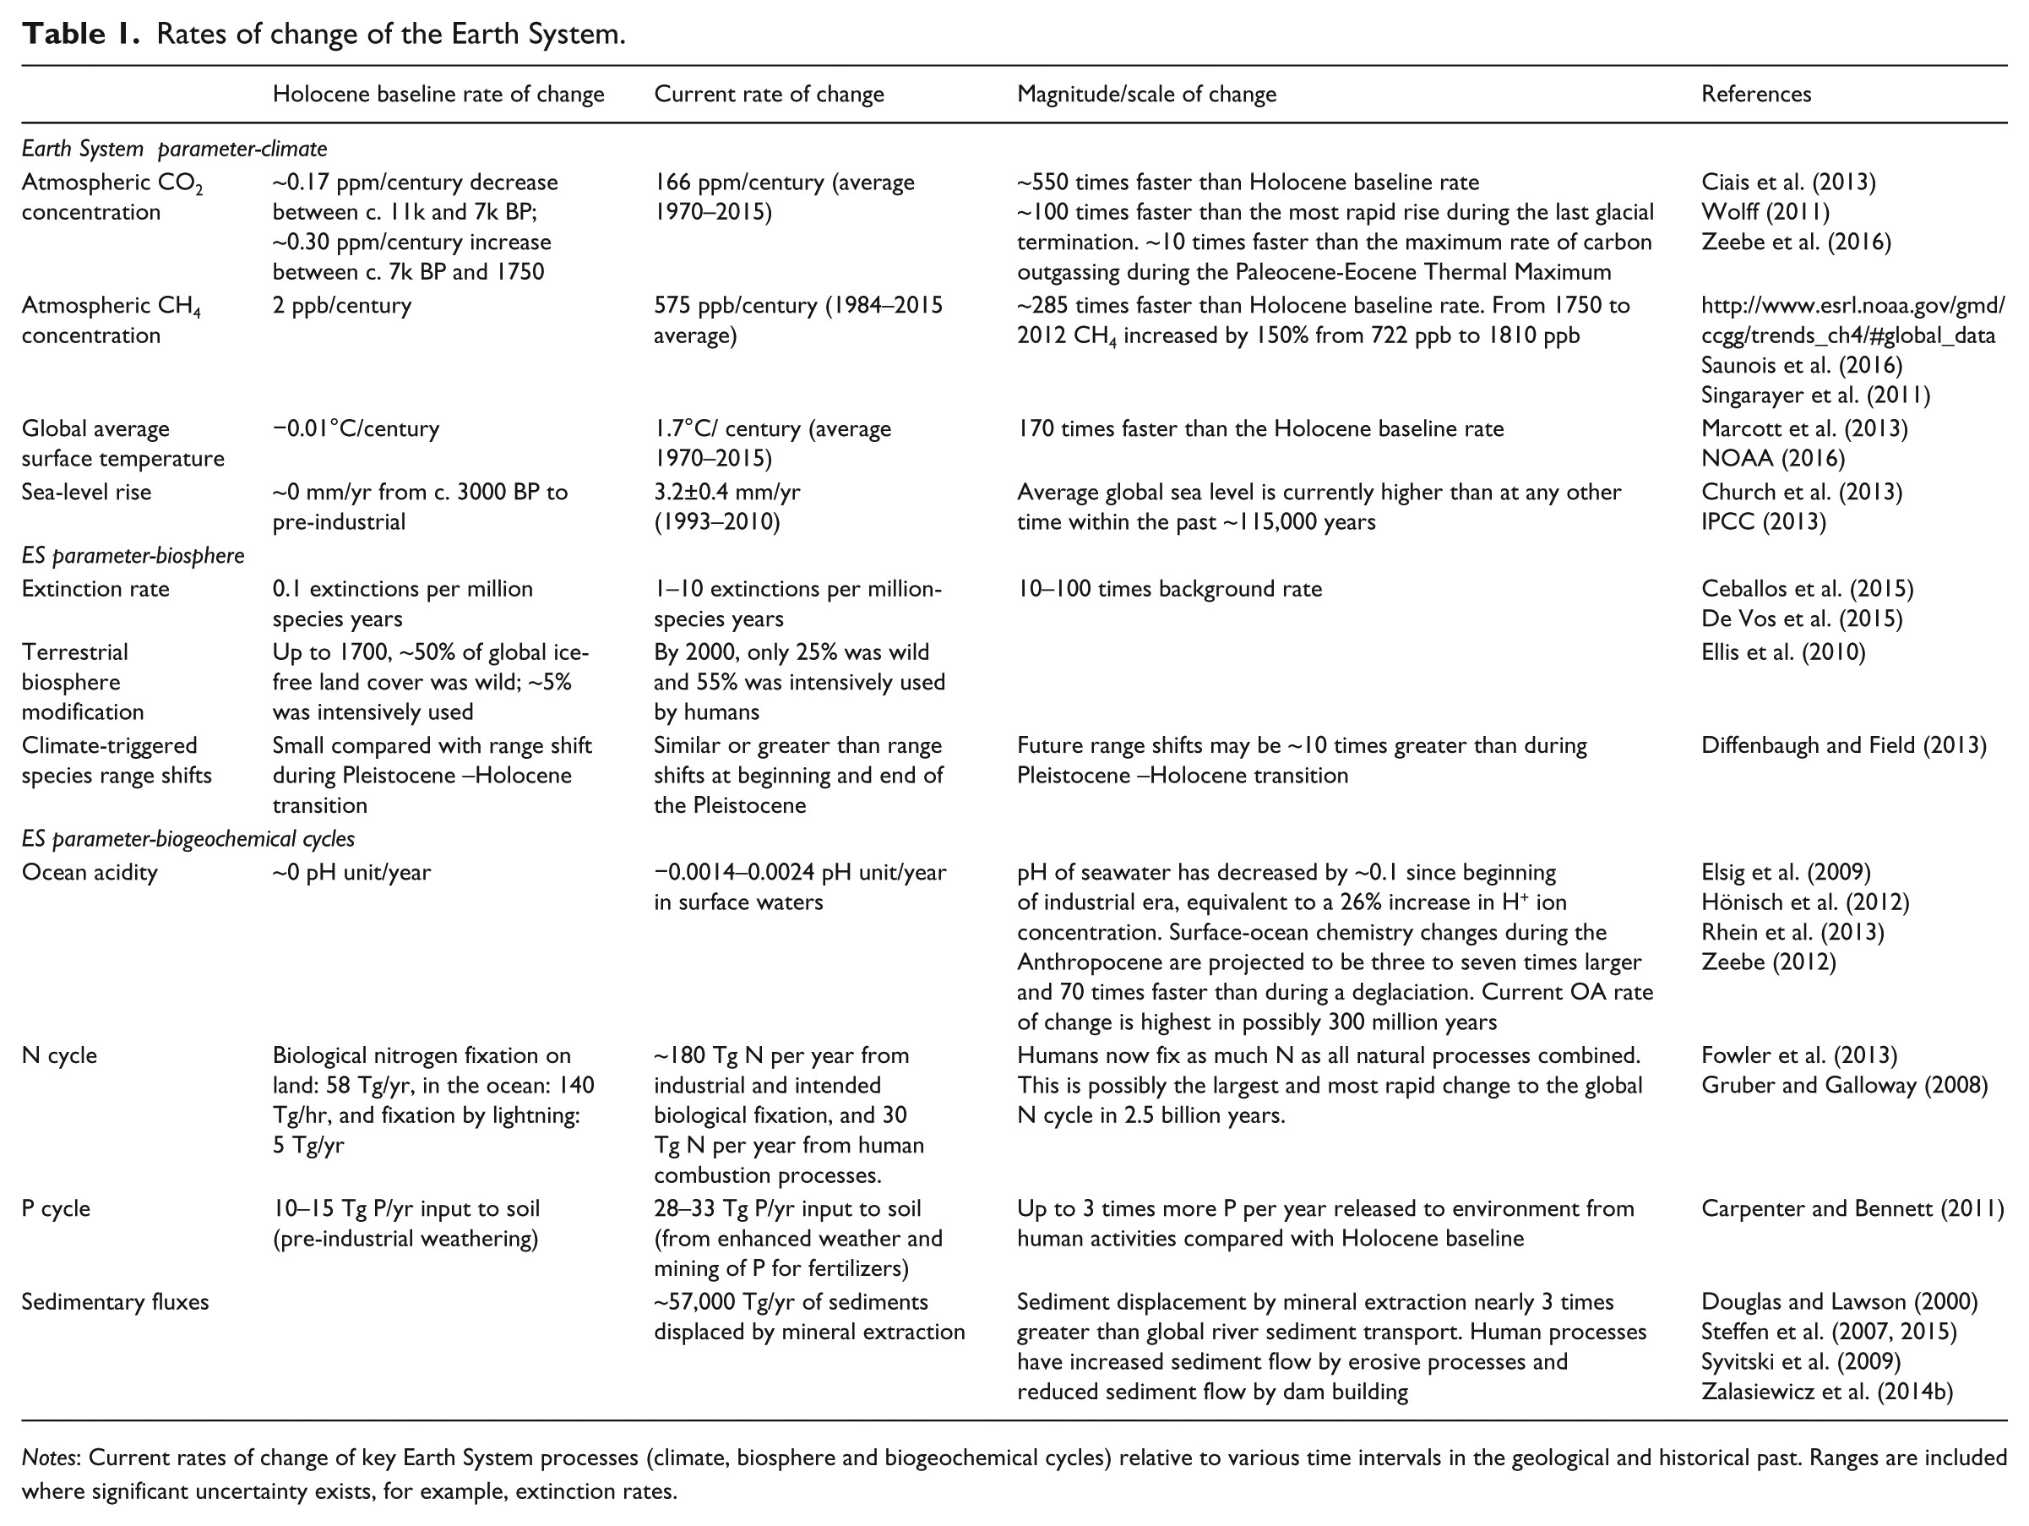
The Diagnosis: Leaving the “Safe Operating Space”
Current rate of change
Global average surface temperature:
~1.7ºC/century
Holocene baseline rate of change
Global average surface temperature:
~0.01ºC/century
Gaffney and Steffen, 2017

Slide 32
The Diagnosis: Leaving the “Safe Operating Space”

Slide 33
Holocene:
Stability
20th and 21st Century:
Change, imbalance
Future:
Uncertainty
10.000 BC
1,900 AD
2,000 AD
Plag, 2016
Text

Slide 34
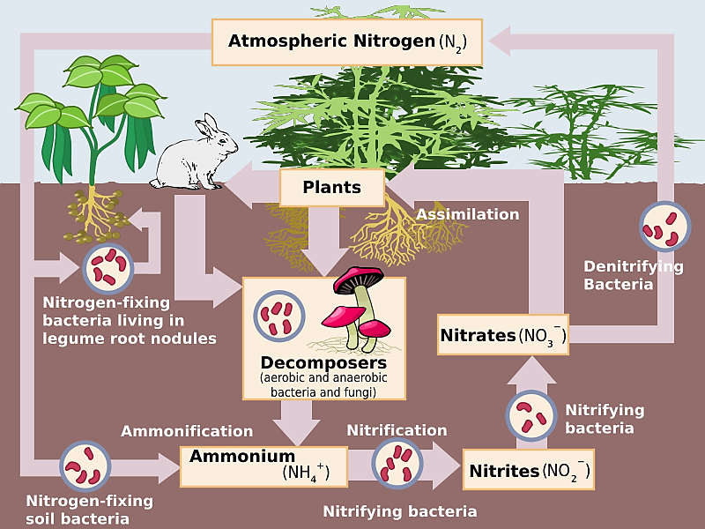
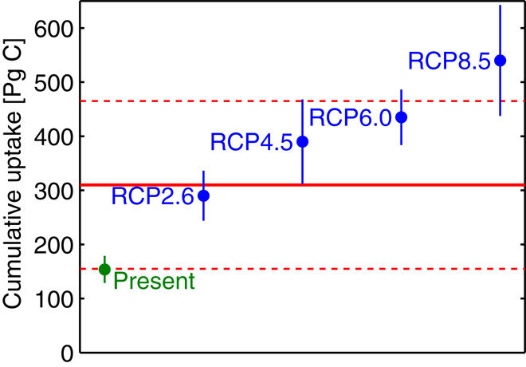
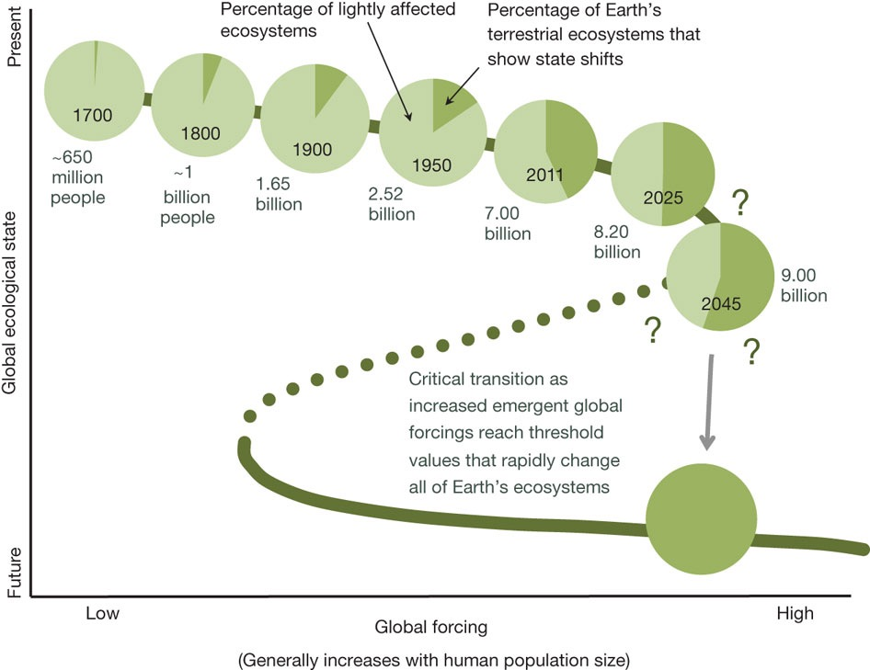
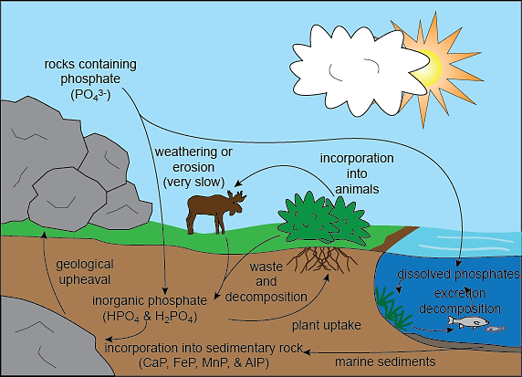
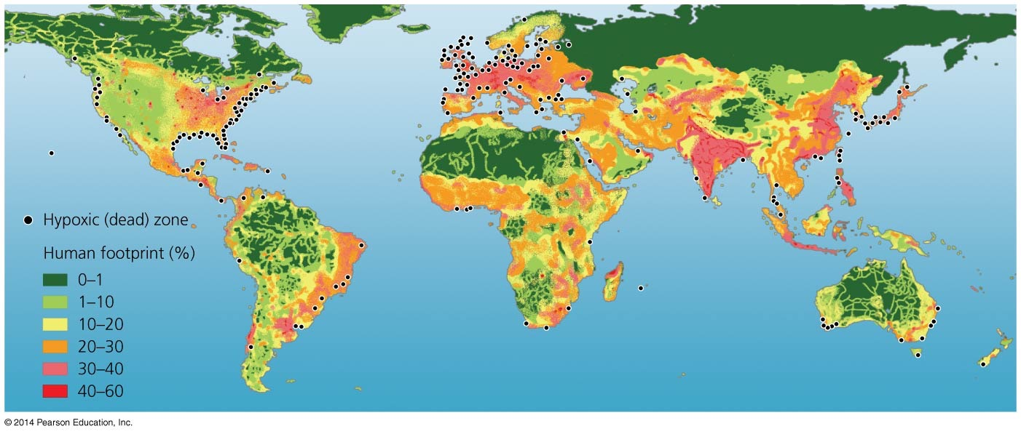
“We are the asteroid …”
The Diagnosis: Leaving the “Safe Operating Space”
Impacts on the Earth’s Life-Support System
“We are the asteroid …”
https://www.youtube.com/watch?v=gPq9YAg9mfc&feature=youtu.be
Current extinction rates:
300 times background rate for birds
80,000 times background rate for mammals
Rothman, 2017
Modern climate change is a symptom, not the cause, not the “sickness.”
Rockstrom and Klum, 2015

Slide 35
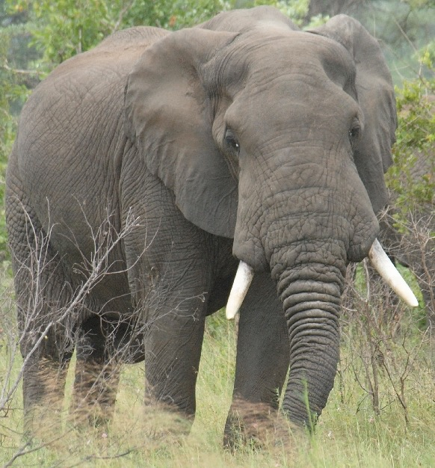
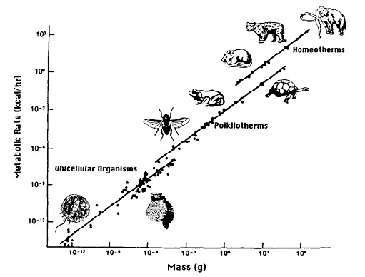
The Diagnosis: Leaving the “Safe Operating Space”
Out of Scale
Scaling law for metabolic rate:
Y = Y0 * M^{(3/4)}
human: Y = 50 -100 Watt
Metabolic Rate
Extended metabolic rate:
YE = Y + CE
(CE: total energy consumption)
Energy consumption per capita:
Global Average: YE = 2,835 Watt
M = 10 metric tons
Humanity has an extended metabolic rate equivalent to 14 Billion elephants
(2.7 Billion for the U.S. alone)
Mass
14 Billion elephants: a heavy “load’ for Earth

Slide 36
The Diagnosis: Leaving the “Safe Operating Space”
22
2 km
impactor
“Single-Species
Cataclysm”
21
Homo sapiens
2.10¹³ W
VEI 8
Toba-Type
Eruption
10¹⁶ W lasting 10⁵ s
20
19
Energy Log (Joules)
VEI 7
Tambora-Type
Eruption
18
M = 9.5
Earthquake
10¹⁷ W lasting
100 s
17
16
15
The Homo sapiens Cataclysmic Virus (HCV) in the Earth’s Life-Support System
0
1
2
3
4
5
6
7
Recurrence Log (Years)

Slide 37
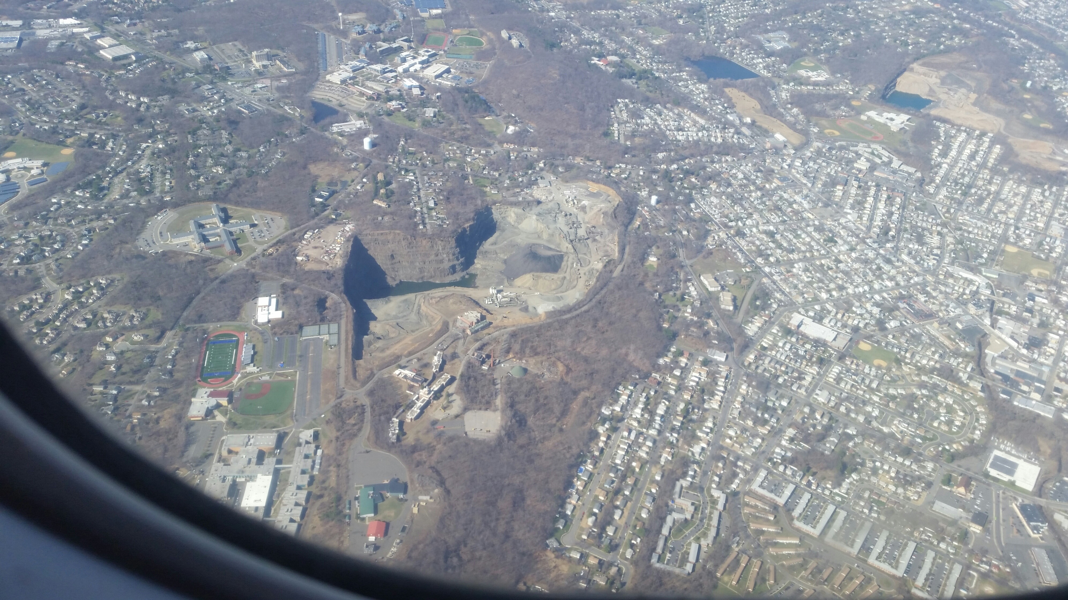
Malignant skin cancer of the planet Plag, 2010
Anthropogenic Cataclysmic Virus (ACV) Plag, 2015
Can the “virus” transform itself into the “healer”?

Slide 38
The Diagnosis: Leaving the “Safe Operating Space”
Breaking Scaling Laws
Brain is the most energy-demanding part in an organism.
Brain to body ratio is limited by energy available to the organism to sustain the metabolic rate.
Great apes such as gorillas and orangutans need to spend hours foraging to have enough energy to sustain the large body frames.
They cannot afford larger brains.
How could Homo sapiens “break” the scaling law?
The human brain represents 2% of body mass, but it uses about 25% of the metabolic rate.
Supporting a large, more efficient brain requires high-energy, easy to process food:
Homo sapiens achieved this by using fire to process food (particularly meat)

Slide 39
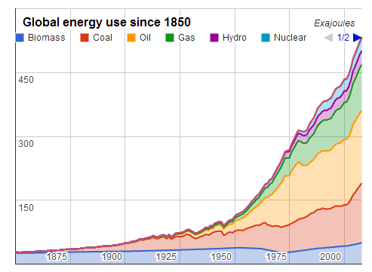
The Diagnosis: Leaving the “Safe Operating Space”
Easy access to seemingly infinite energy combined with technology
Increasing food efficiency and reducing time needed to process food
Increasing access to material resources
Mainly a light-skinned (almost white) subspecies from Europe
Homo sapiens
Colonizers
Holocene
Single-Species Dominance
Post-Holocene
Goal of economy is to create “human wealth”
Adam
Smith
Technology and access to fossil fuels facilitate economic growth
10⁶
10⁵
10⁴
10³
10²
10¹
10⁰
10¹
10²
10³
Reducing time needed to obtain food
Years BP
2000
Years
Accumulate, accumulate, …
Population
4 M
50 M
1.6 B
5.3 B
6.0 B
6.9 B
12 B?
?
Total energy use
<10⁻⁶ TW
<10⁻³ TW
0.5 TW
10.0 TW
12.8 TW
16.5 TW
>100.0 TW?

Slide 40
The Diagnosis: Leaving the “Safe Operating Space”
Role of Economy
In 2008, people around the world used 68 billion tons of materials, including metals and minerals, fossil fuels, and biomass. That is an average of 10 tons per person— or 27 kilograms each and every day. That same year, humanity used the biocapacity of 1.5 planets, consuming far beyond what the Earth can sustainably provide.
Assadourian, 2013
World Extraction of Non-Renewable Materials
The urban population in the developing world will double by 2030. The implications are staggering. One is that we have 20 years to build as much urban housing as was built in the past 6,000. Reinhard Goethert, School of Architecture and Planning, MIT, 2010.

Slide 41
The Diagnosis: Leaving the “Safe Operating Space”
Role of Economy
The Jevons Paradox is the product of a capitalist economic system that is unable to conserve on a macro scale, geared, as it is, to maximizing the throughput of energy and materials from resource tap to final waste sink. Energy savings in such a system tend to be used as a means for further development of the economic order, generating what Alfred Lotka called the “maximum energy flux,” rather than minimum energy production.
An economic system devoted to profits, accumulation, and economic expansion without end will tend to use any efficiency gains or cost reductions to expand the overall scale of production. Technological innovation will therefore be heavily geared to these same expansive ends. It is no mere coincidence that each of the epoch-making innovations (namely, the steam engine, the railroad, and the automobile) that dominated the eighteenth, nineteenth, and twentieth centuries were characterized by their importance in driving capital accumulation and the positive feedback they generated with respect to economic growth as a whole—so that the scale effects on the economy arising from their development necessarily overshot improvements in technological efficiency.

Slide 42
Key Points
Baseline
During the Holocene, climate and sea level were exceptionally stable
The Holocene was a “safe operating space for humanity”
Syndrome
During the last few hundred years, humanity has introduced rapid and large changes
The system is outside the “normal range” and in the dynamic transition into the Post-Holocene; we have increasing disequilibrium
Diagnosis
Easy access to seemingly unlimited energy allowed humans to accelerate flows in the Earth’s life-support system and sustain rapid population growth and increasing demands
Humans are the “Anthropogenic Cataclysmic Virus” (ACV) in the Earth’s life-support system

Slide 43
Modern Climate Change: A Symptom of Humanity’s Evolution into a Growth-Addicted Industrialized Civilization
Contents
The Baseline: Past Climate Changes
The Syndrome: Recent Climate and Global Change
The Diagnosis: Leaving the “Safe Operating Space”
The Prognosis: Journey Into the Unknown
The Therapy: “Lifestyle” changes
Hans-Peter Plag
February 9, 2016

Slide 44
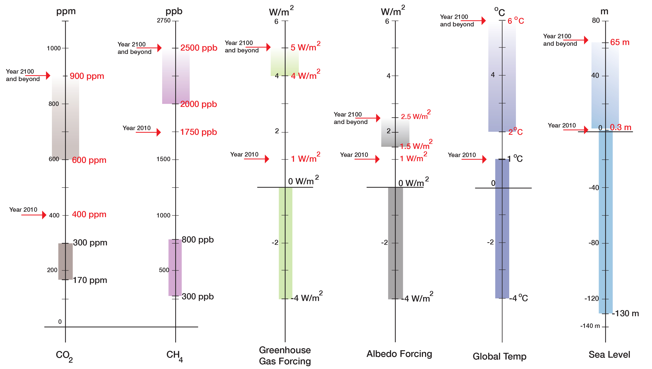
Prognosis: Journey into the Unknown
Baseline and Changes
“Prognosis”
“Current State”
“Normal Range”
(800,000 years)

Slide 45
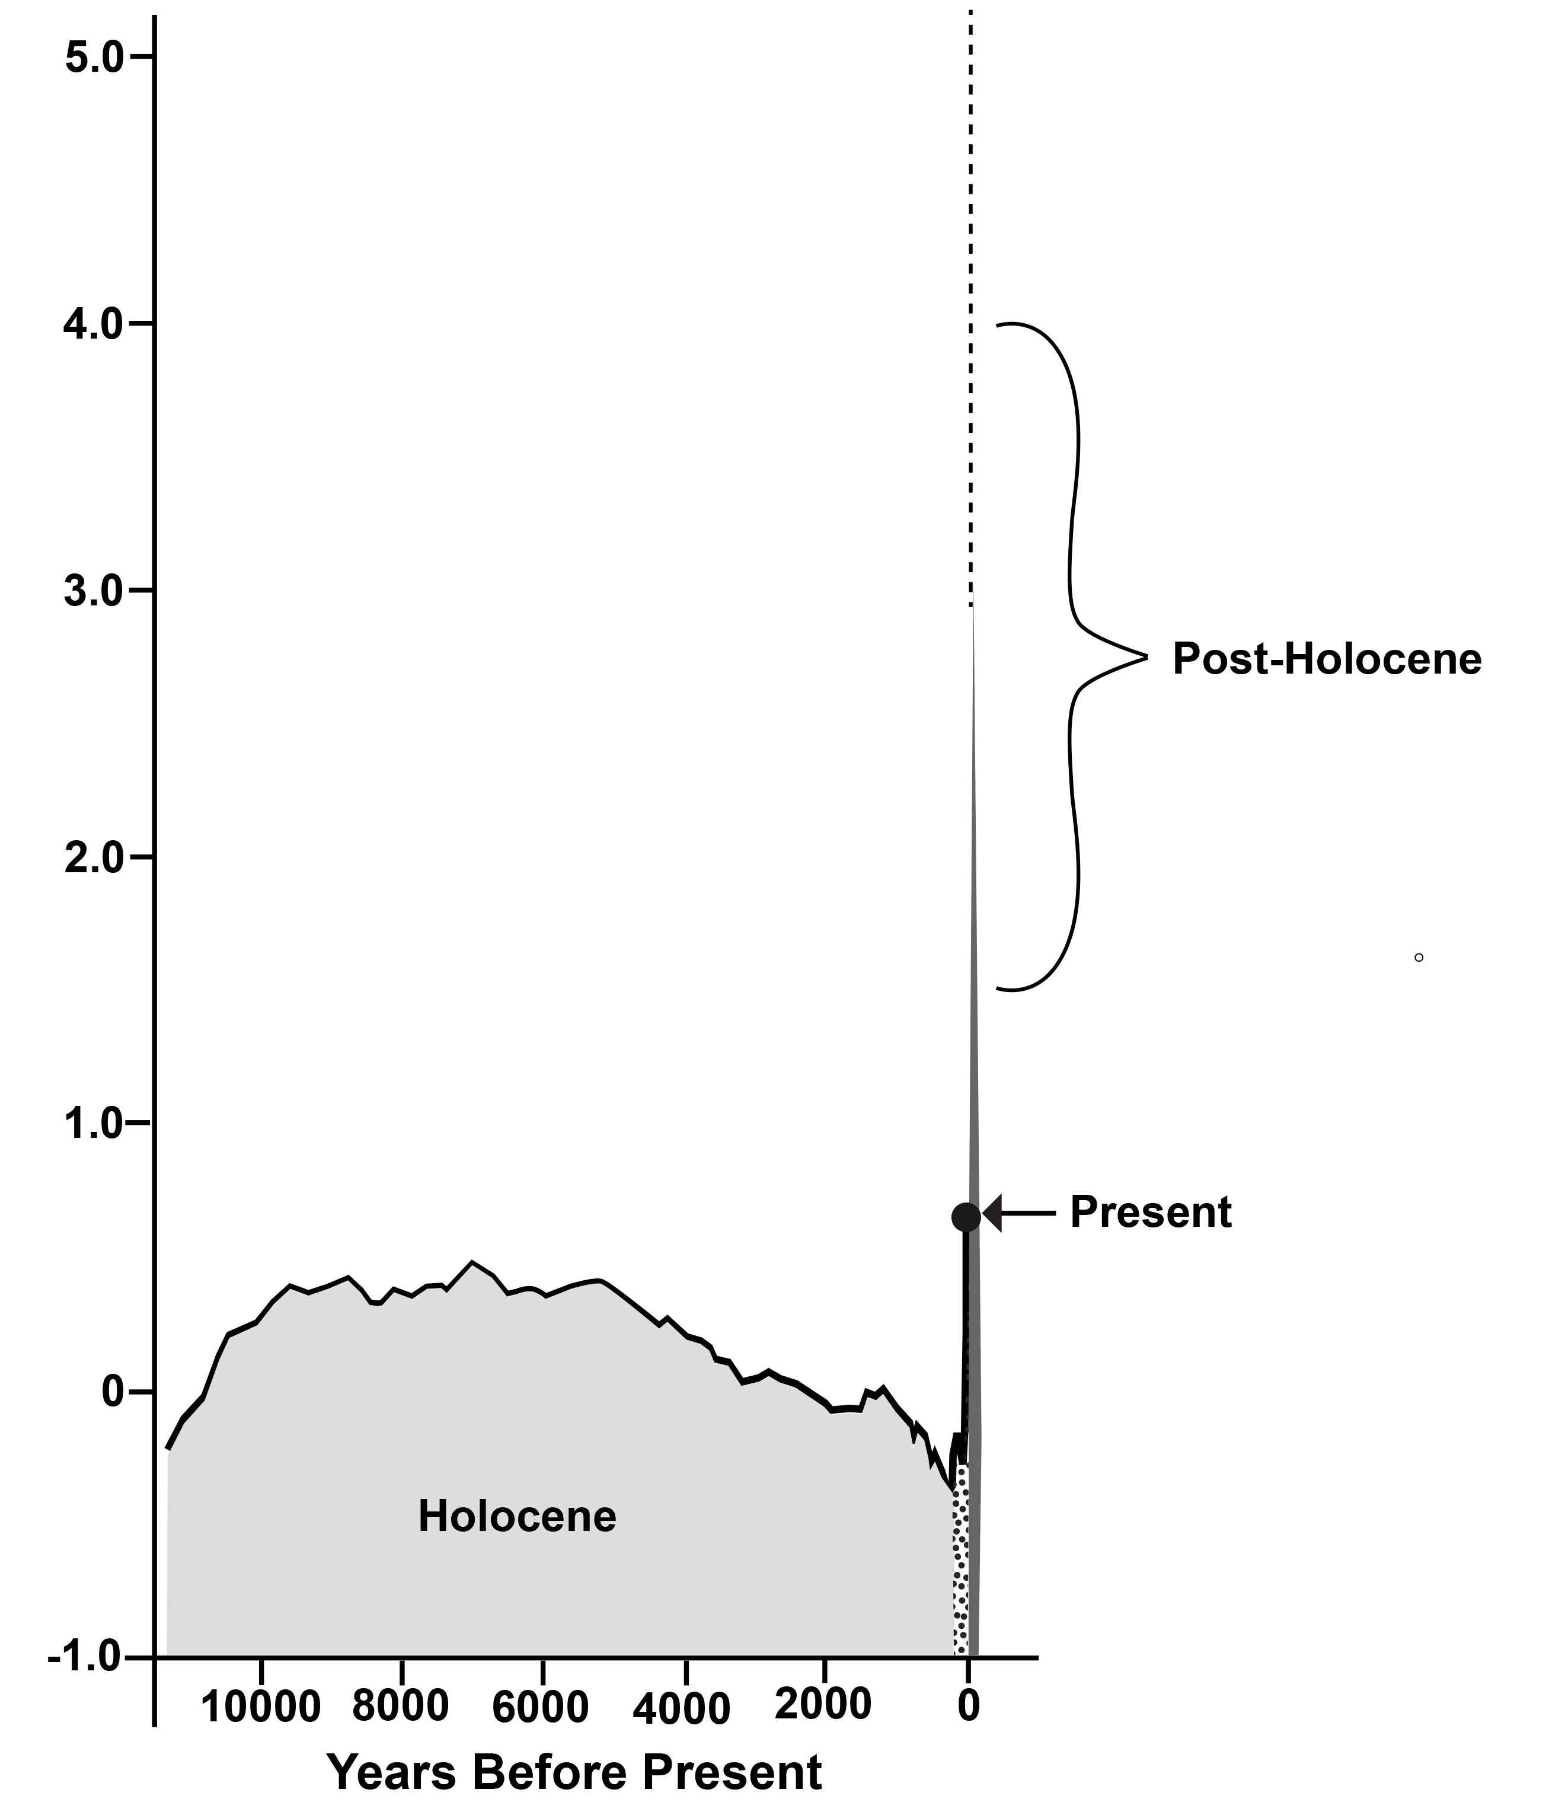
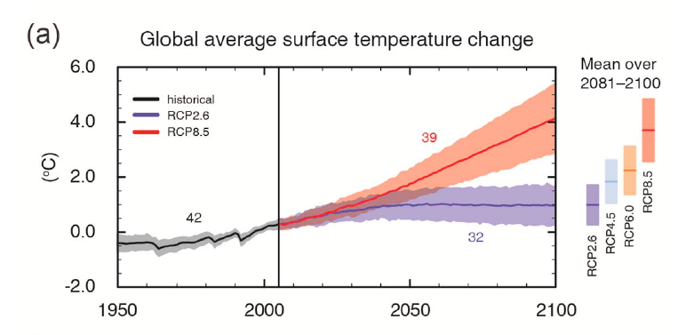
Prognosis: Journey into the Unknown

Slide 46
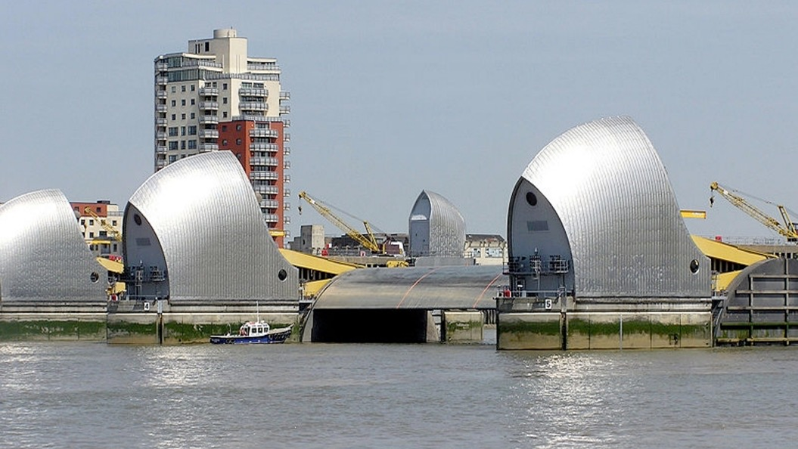
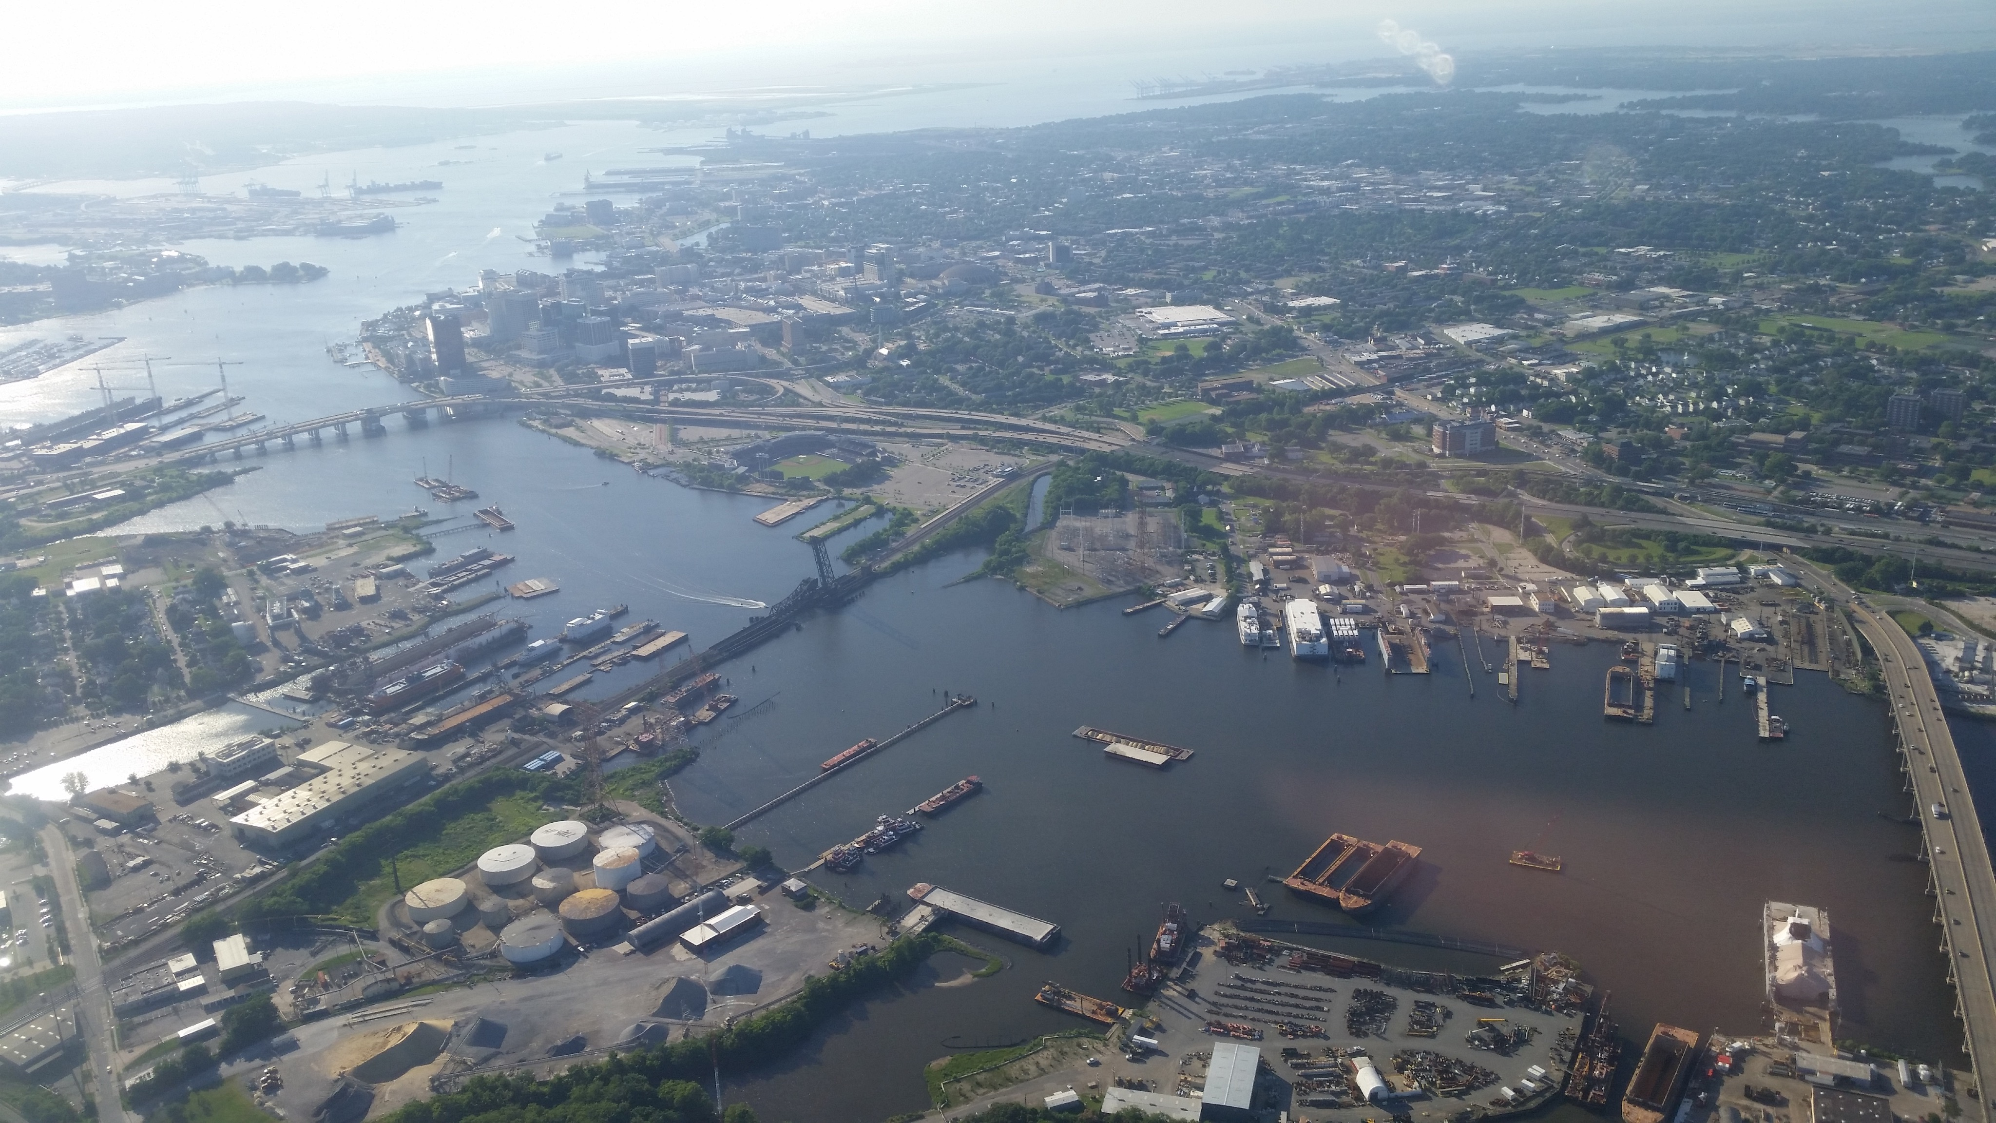
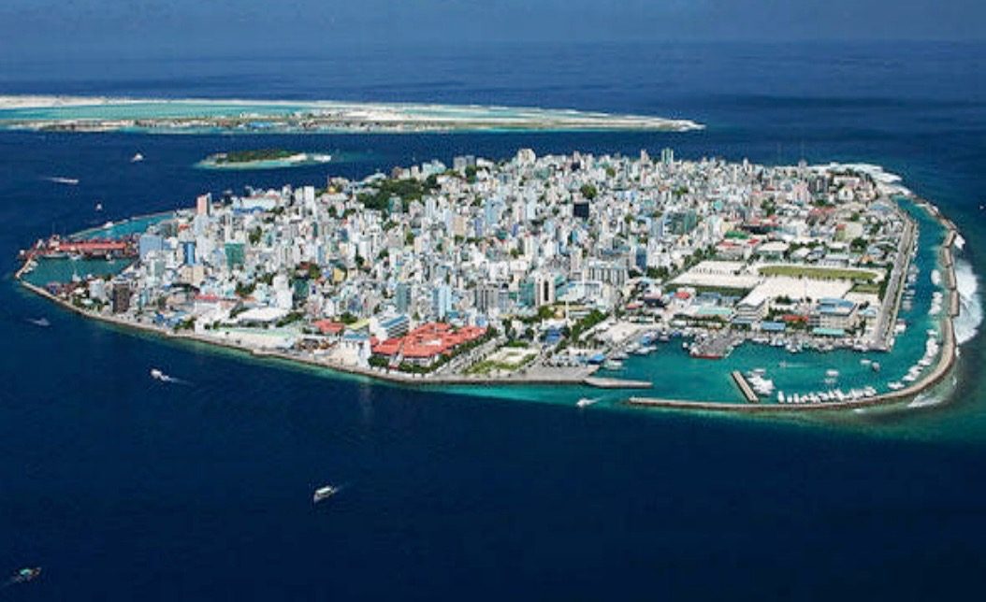
The Prognosis: Journey Into the Unknown
Build mobile infrastructure and buildings
Slowly divest in exposed coastal areas
Eventually, protections will fail
Longer-term:
1ºC corresponds to about 25 m in sea level
Expect large sea level rise over several centuries (several meters to >20 m)
Horizontal migration of coasts
Pollution of inundated coastal areas and waters
Prepare for loss of coastal cities
We have committed to an ice-free planet: eventually 65 m (195 ft) of sea level rise
(1000 - 5000 years)
Costs might be very high
Zillow study:
1.8 m by 2100
36 U.S. Coastal Cities lost;
more than 50 cities lose at least 50% of residential real estate
$1 Trillion in loss (2% of residential real estate value)
Clean up the coastal zone
This century
0 1 2 3 4 m

Slide 47
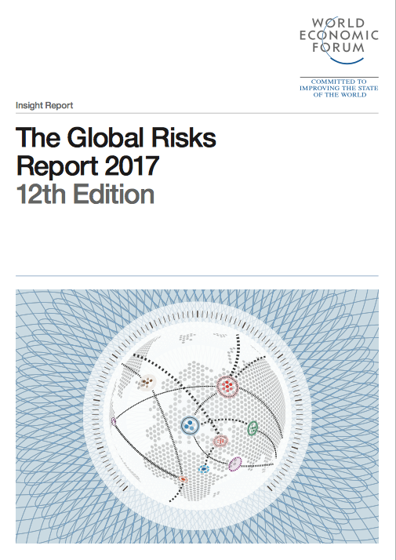
The Prognosis: Journey Into the Unknown
Assessing the risk …

Slide 48
The Prognosis: Journey Into the Unknown
Assessing the risk …
Homo sapiens have a huge amount of data and knowledge

Slide 49
Prognosis: Journey into the Unknown
Do I know what is ahead?
What do I need to know?
Am I on the right track?
Do I understand the challenge?
Who is going to be impacted?
Who can help me?
What should I do?

Slide 50
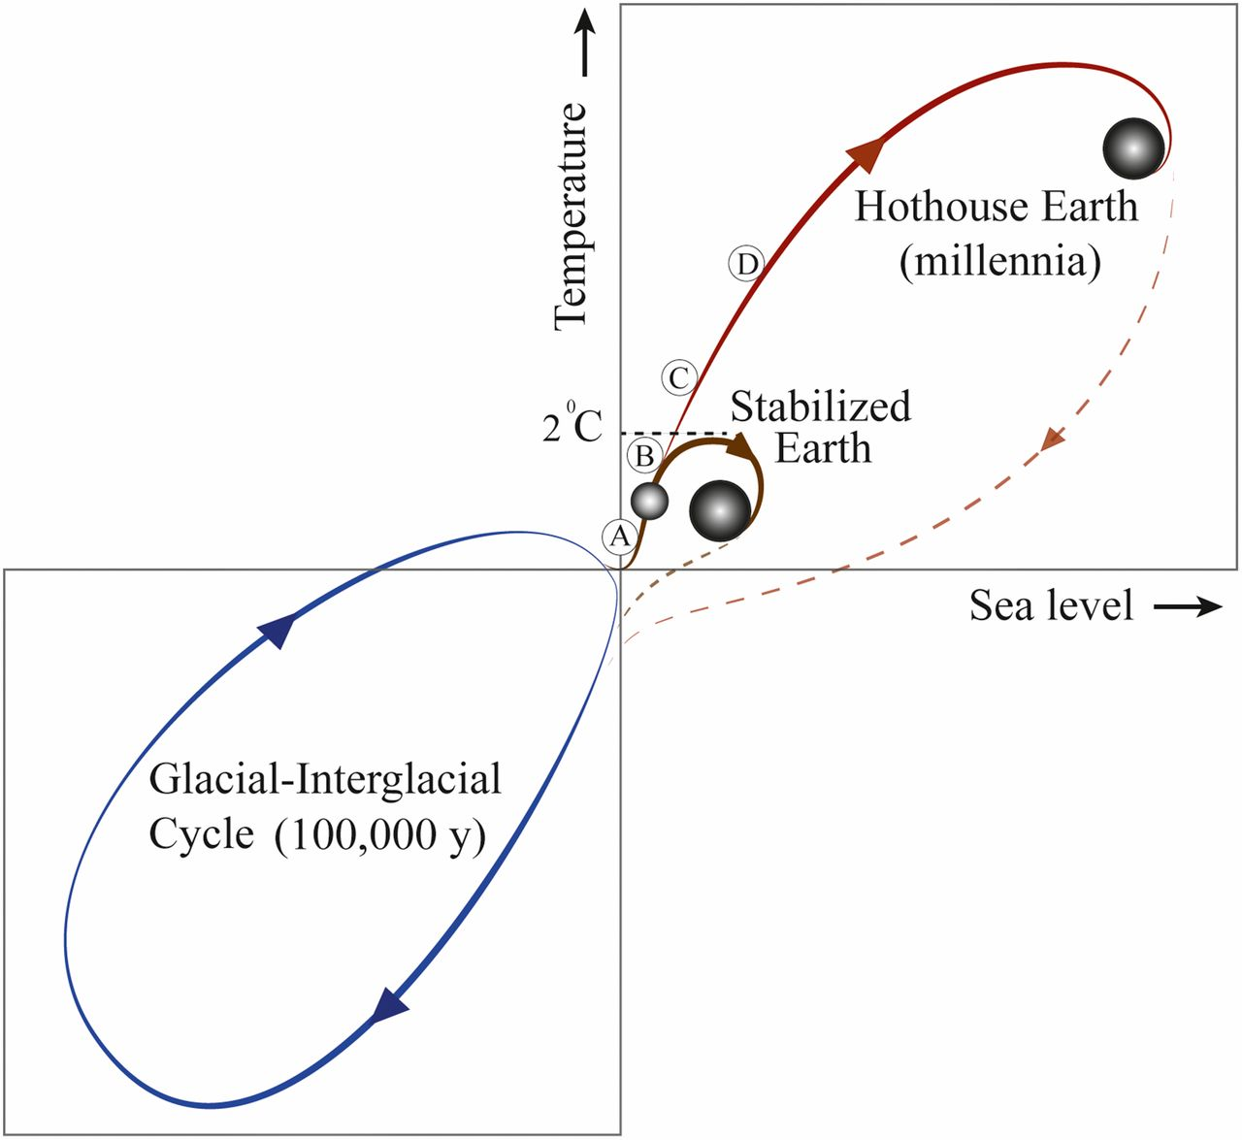
Prognosis: Journey into the Unknown

Slide 51
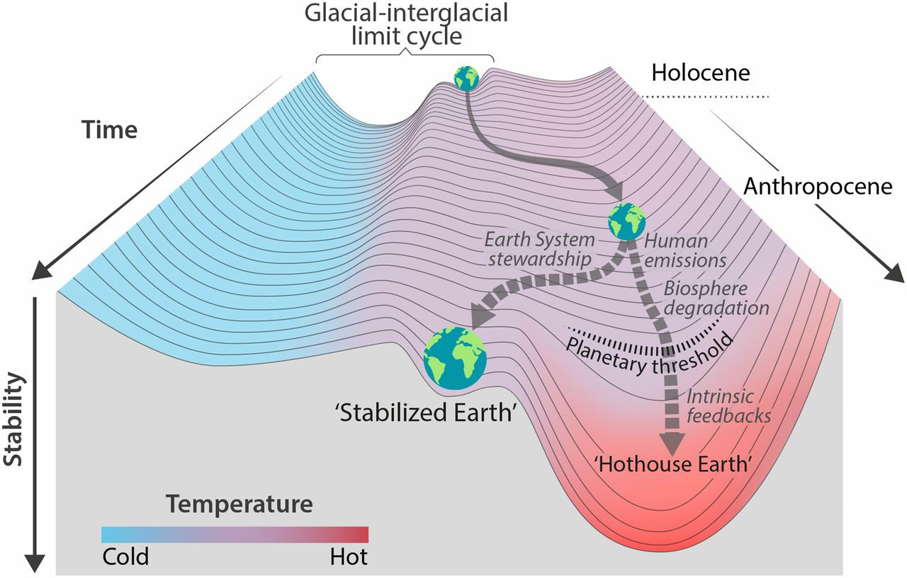
Prognosis: Journey into the Unknown
Anthropocene or
Post-Holocene?

Slide 52
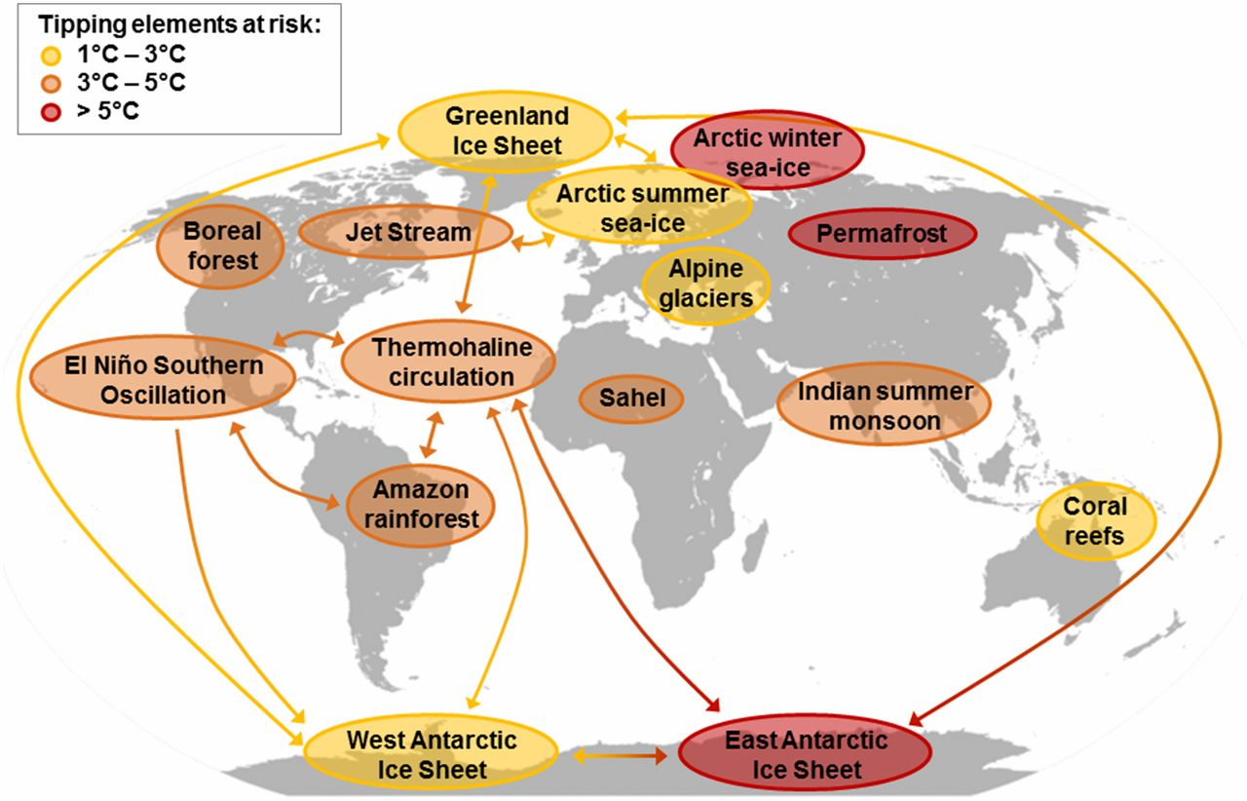
Prognosis: Journey into the Unknown
Extinction of mammals and birds
Extinction of insects
Loss of soil

Slide 53
Prognosis: Journey into the Unknown
95% in extreme poverty
Adam Smith:
The purpose of economy is to create human wealth.
1950 Syndrome
Humanity has been extremely successful as a species on this planet in changing the planet
We are the operators of Earth’s life-support system

Slide 54
Prognosis: Journey into the Unknown
Even if carbon emissions are reduced, the ocean is still set for centuries or more of warming, acidification, deoxygenation, and sea level rise.

Slide 55
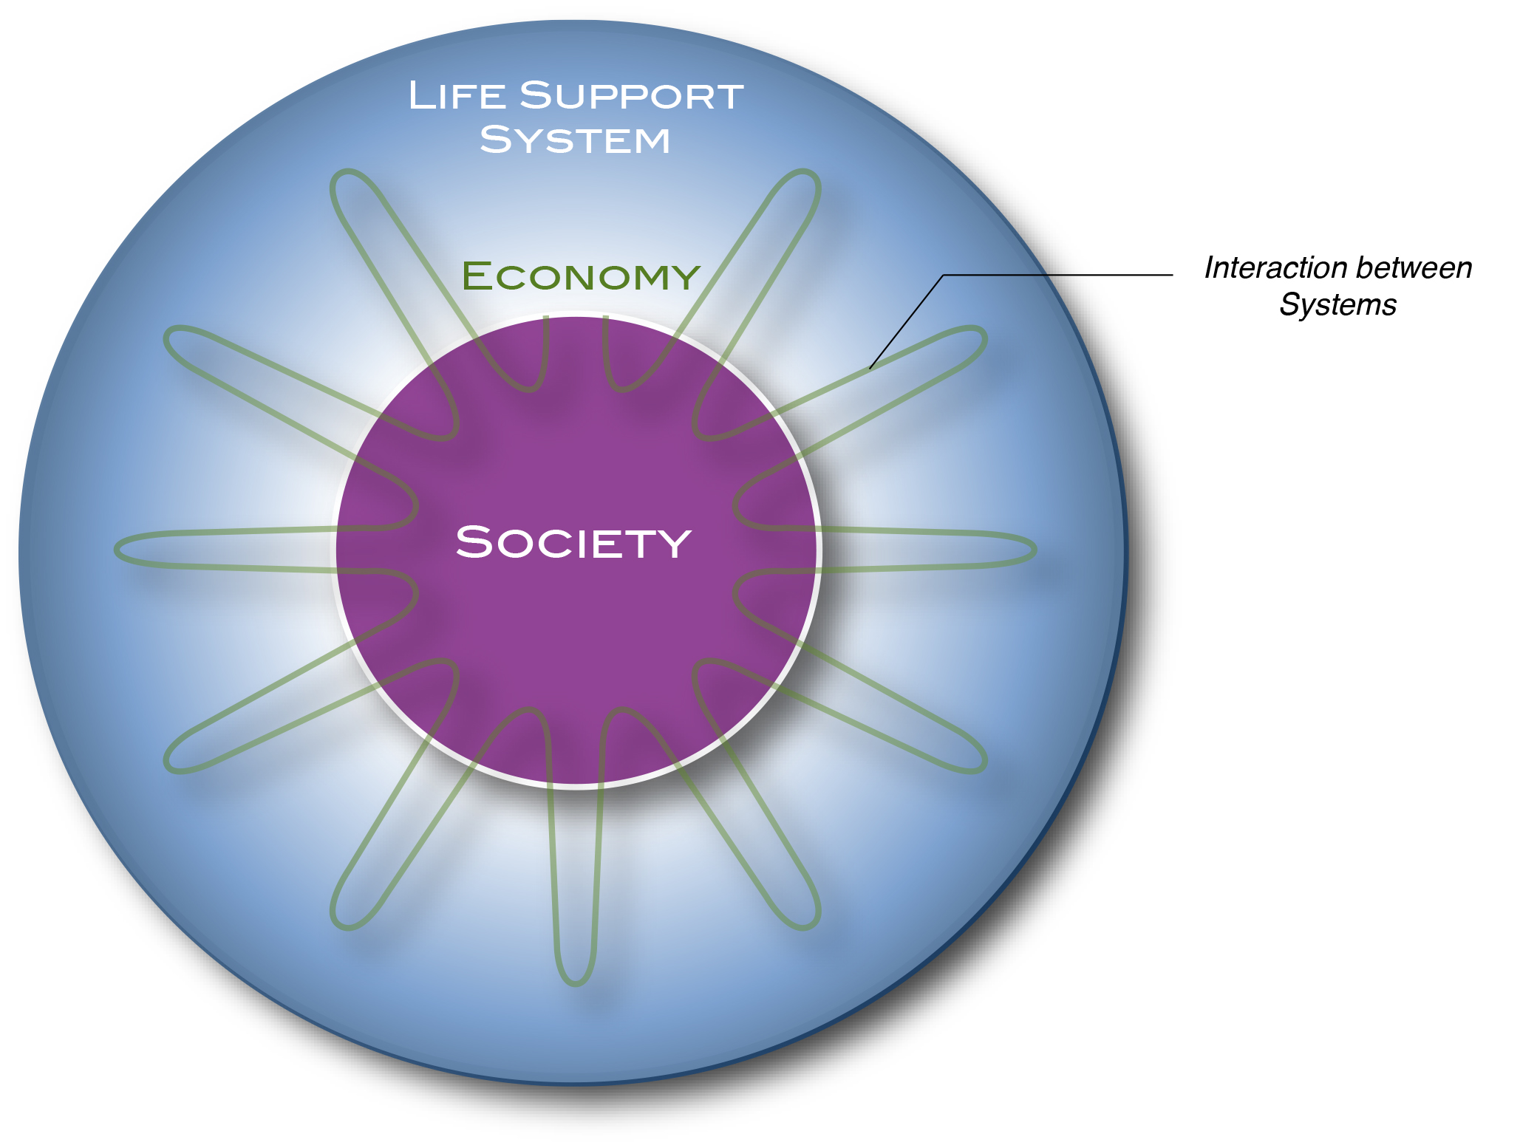
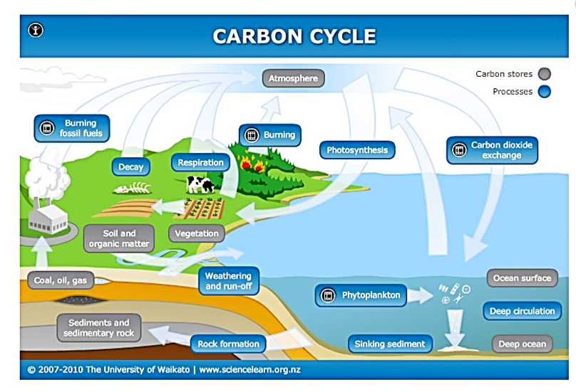
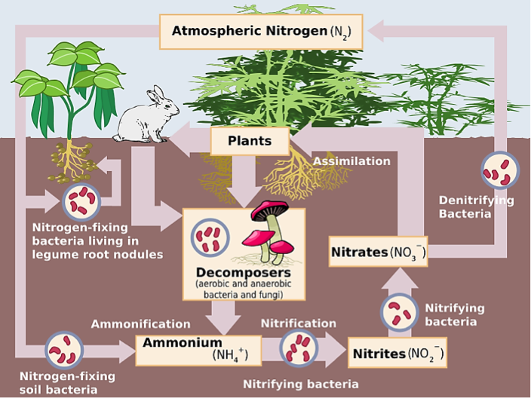
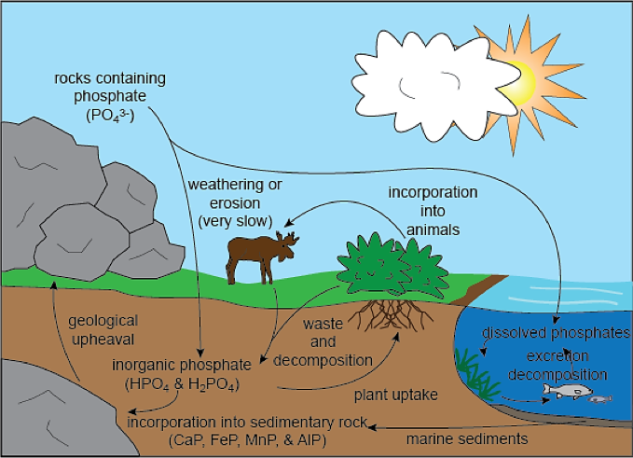
Prognosis: Journey into the Unknown
Physiology of the Life-Support System: Flow
Flows
Hypoxic (dead) zones
Freshwater: 81% since 1970
Current extinction rates:
300 times background rate for birds
80,000 times background rate for mammals

Slide 56
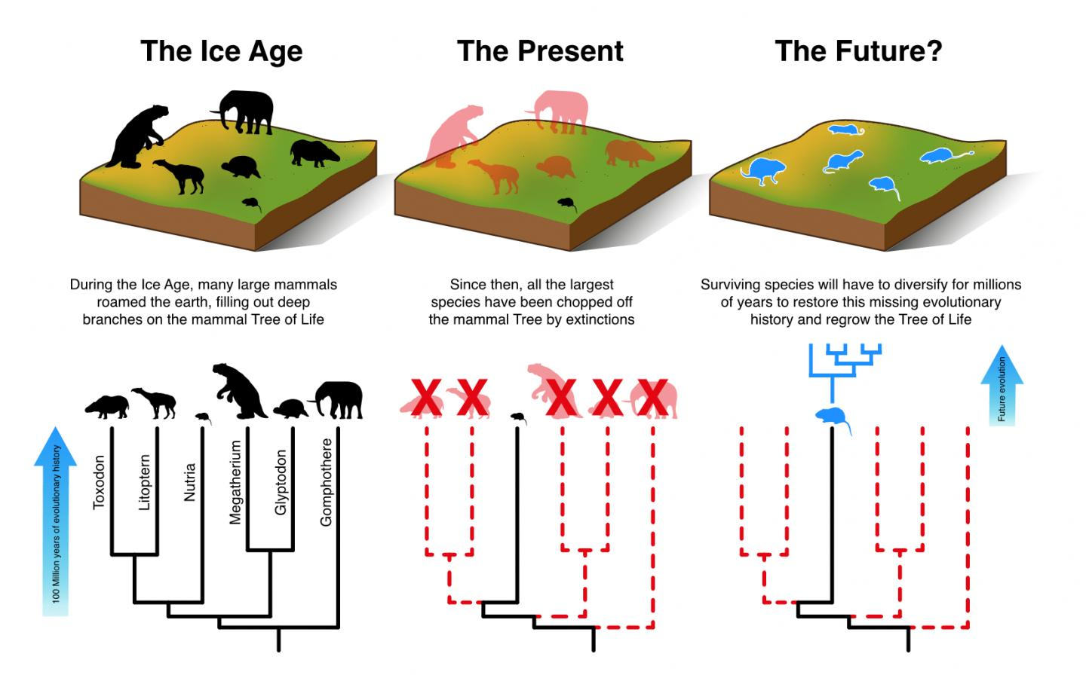
Prognosis: Journey into the Unknown
Davis et al., 2018

Slide 57
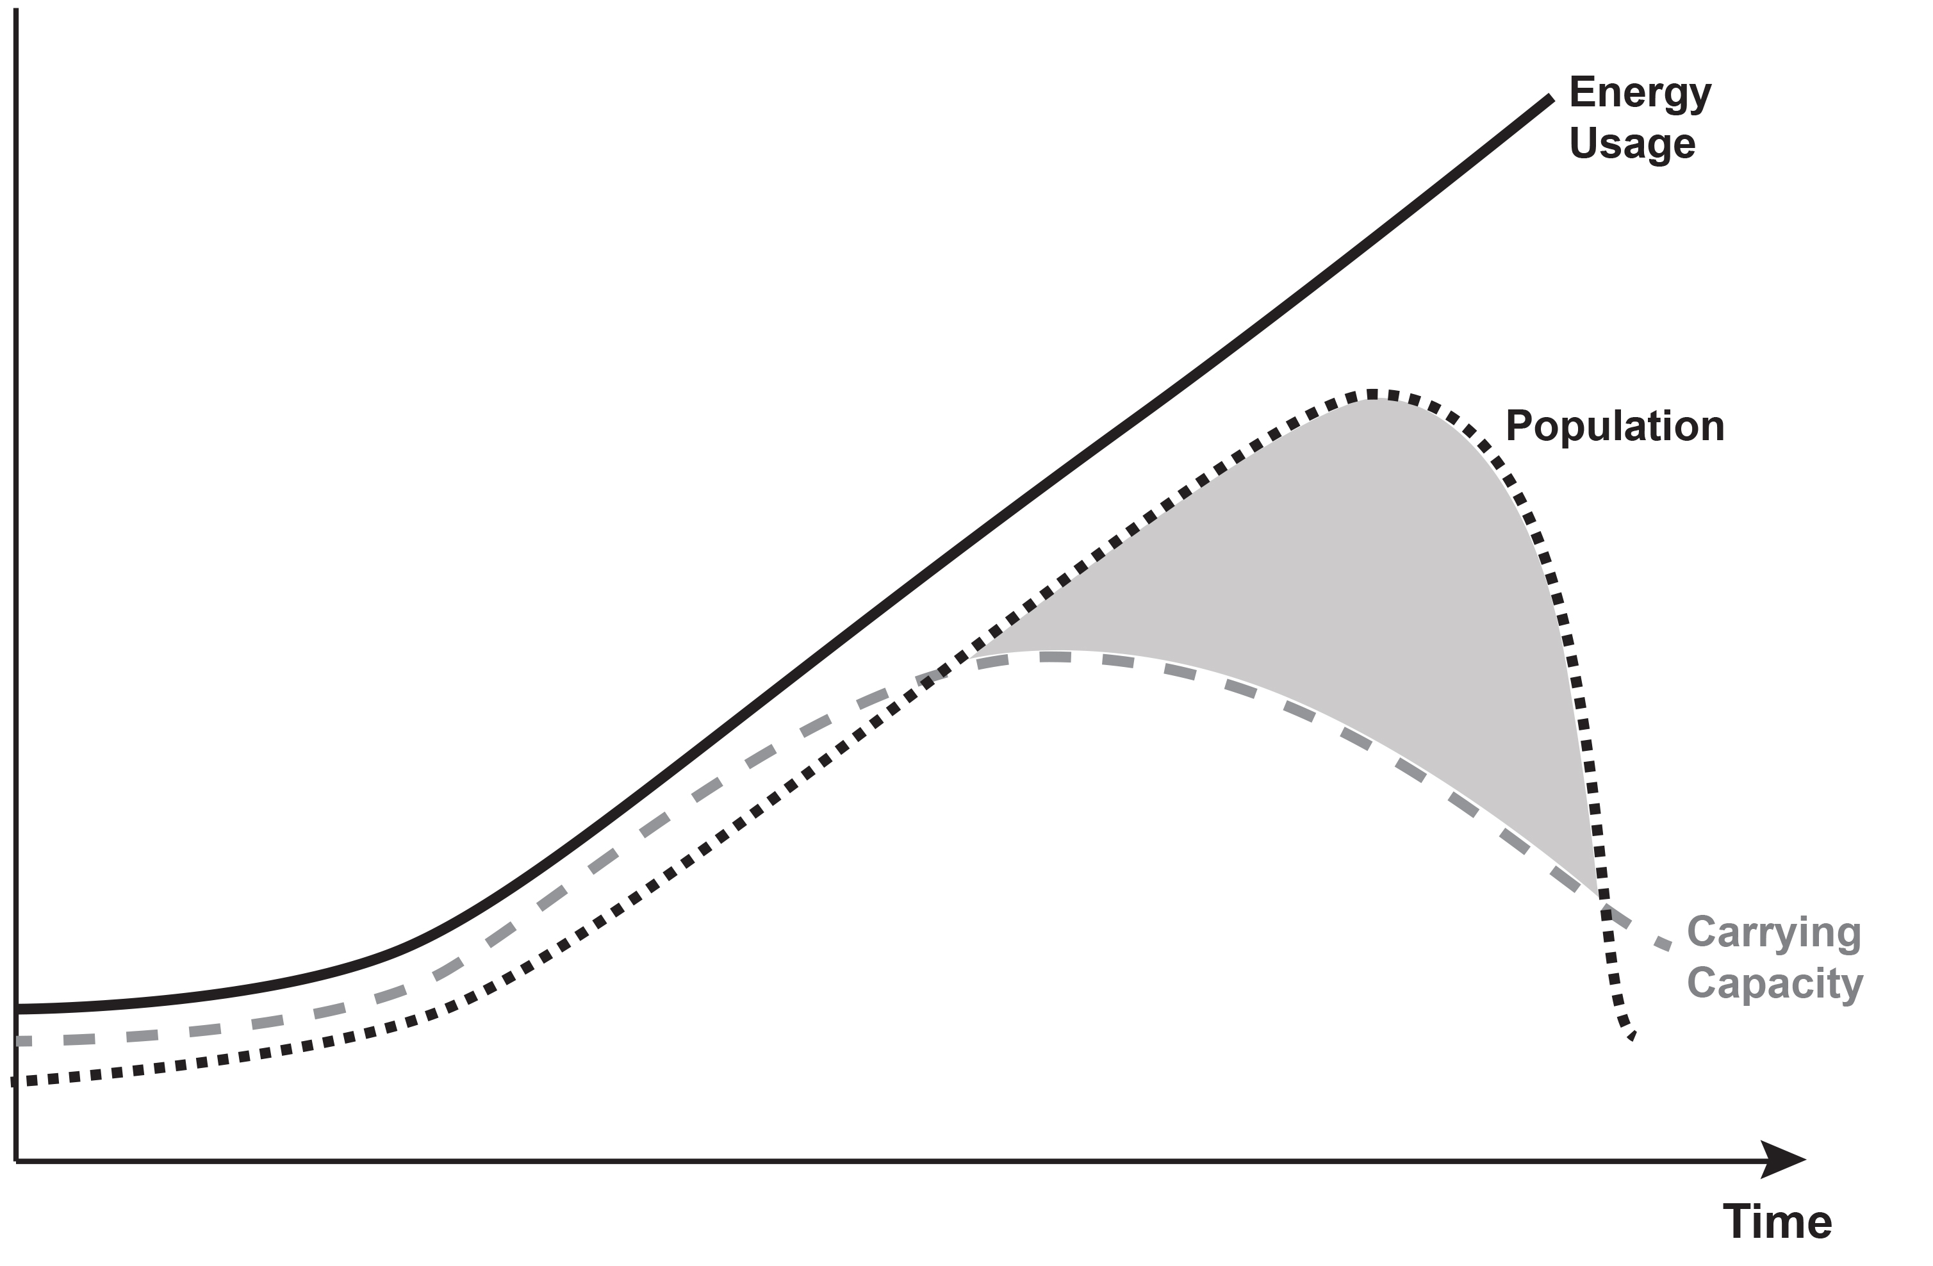
Prognosis: Journey into the Unknown
"Yet in all societies, even those that are most vicious, the tendency to a virtuous attachment is so strong that there is a constant effort towards an increase of population” Malthus, 1798.
“That the increase of population is necessarily limited by the means of subsistence, That population does invariably increase when the means of subsistence increase, and, That the superior power of population is repressed, and the actual population kept equal to the means of subsistence, by misery and vice.”
Malthus, 1798.
Lovelock: Carrying Capacity will be down to
1 Billion in 2050

Slide 58
Prognosis: Journey into the Unknown
Humans have all the Knowledge …
Homo sapiens have a huge amount of data and knowledge
Homo sapiens have (controversial) ideas about how to fix the problems
But they use reason more to find fault in others’ thoughts than to agree on a common future
Published in 1987
Published in 2009
Published in 2016
Published in 2018

Slide 59
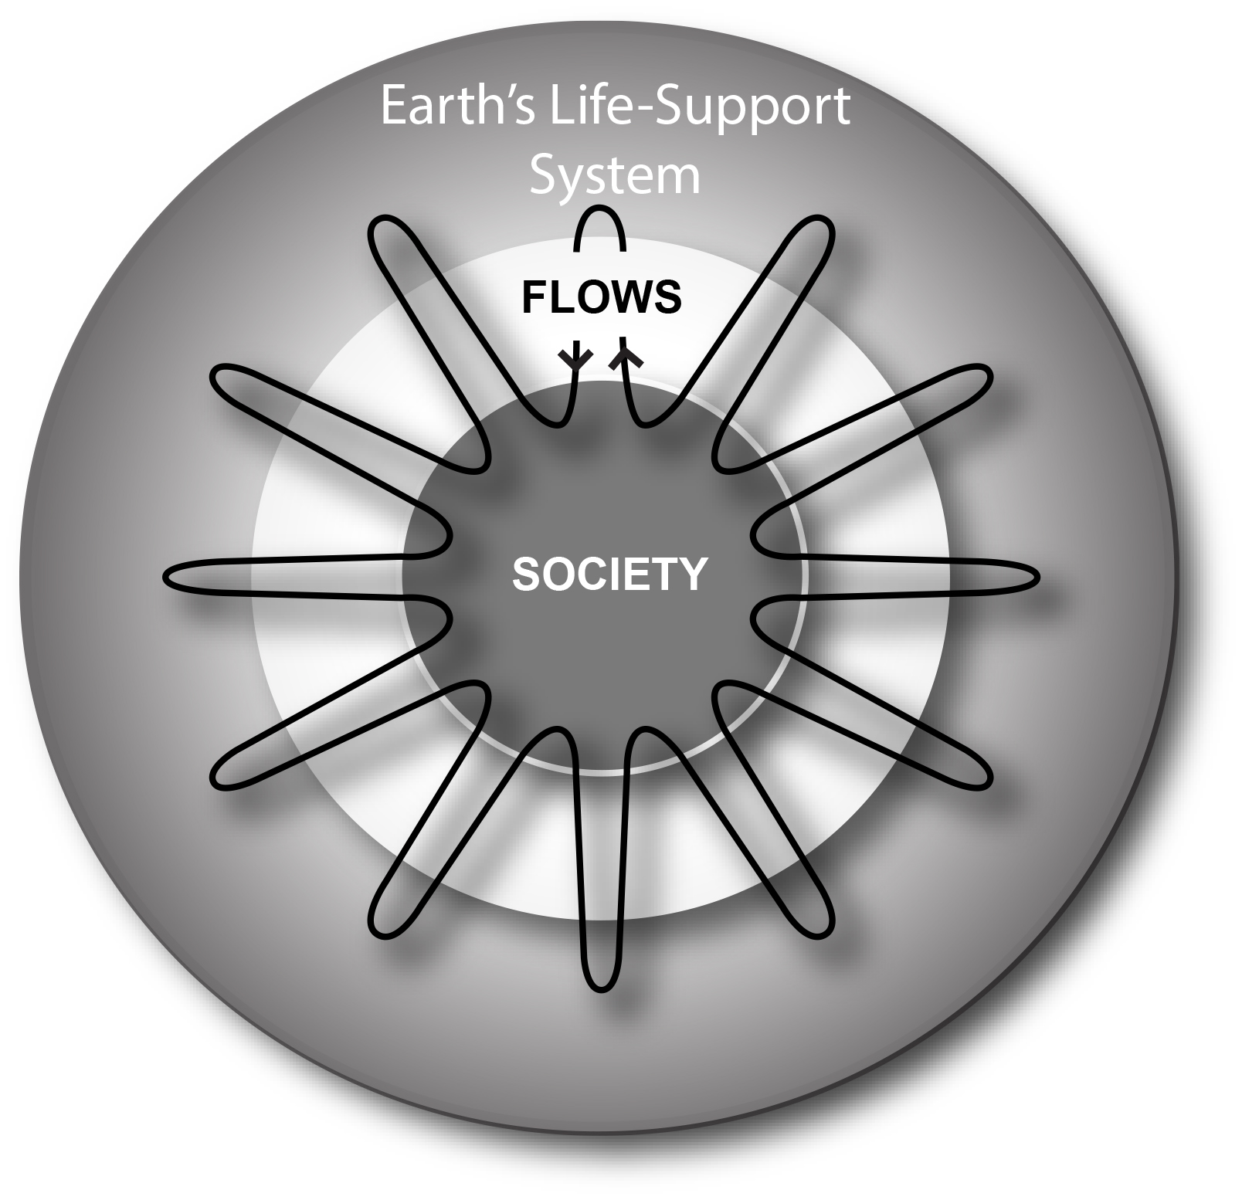

Slide 60
Key Points
Baseline
During the Holocene, climate and sea level were exceptionally stable
The Holocene was a “safe operating space for humanity”
Syndrome
During the last few hundred years, humanity has introduced rapid and large changes
The system is outside the “normal range” and in the dynamic transition into the Post-Holocene; we have increasing disequilibrium
Diagnosis
Easy access to seemingly unlimited energy allowed humans to accelerate flows in the Earth’s life-support system and sustain rapid population growth and increasing demands
Humans are the “Anthropogenic Cataclysmic Virus” (ACV) in the Earth’s life-support system
Prognosis
We are heading rapidly into a very different system state (tippingpoints; Post-Holocene)
Our knowledge is changing rapidly; there is room for surprises; Foresight is needed

Slide 61
Modern Climate Change: A Symptom of Humanity’s Evolution into a Growth-Addicted Industrialized Civilization
Contents
The Baseline: Past Climate Changes
The Syndrome: Recent Climate and Global Change
The Diagnosis: Leaving the “Safe Operating Space”
The Prognosis: Journey Into the Unknown
The Therapy: “Lifestyle” changes
Hans-Peter Plag
February 9, 2016

Slide 62
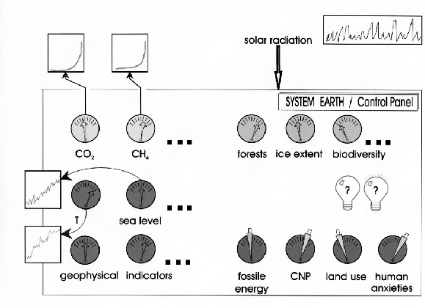
The planetary life-support system is rapidly degrading and overheating; ; They are heading for a mono-species system
Homo sapiens keep accumulating “wealth” while destroying their life-support system
Their system knowledge increases, and for the first time, they can see the control levers, knobs and switches that drive the Earth system
But they don’t have the control panel, the cockpit to control and operate the system
Before we leave, a recommendation for humanity …
Plag, 2000
Importantly, they don’t have a design plan and there is no planetary governance to take the system to a future desirable for Homo sapiens

Slide 63
Homo Sapiens’ Economy and Earth’s Life-Support System
For Homo sapiens, flows are regulated by
ethics,
social norms,
economic rules
Published in 1776

Slide 64
Homo Sapiens’ Economy and Earth’s Life-Support System
Purpose of economy is to increase human wealth;
Earth and its natural wealth is basically infinite.
Smith (1776)
Published in 1776

Slide 65
Homo Sapiens’ Economy and Earth’s Life-Support System
Purpose of economy is to increase human wealth;
Earth and its natural wealth is basically infinite.
Smith (1776)
"Sustainable development is development that meets the needs of the present without compromising the ability of future generations to meet their own needs”.
WCED (1987)
Published in 1987

Slide 66
Homo Sapiens’ Economy and Earth’s Life-Support System
Purpose of economy is to increase human wealth;
Earth and its natural wealth is basically infinite.
Smith (1776)
"Sustainable development is development that meets the needs of the present without compromising the ability of future generations to meet their own needs”.
WCED (1987)
“Sustainable Development is a development that meets the needs of the present while safeguarding Earth’s life support systems, on which the welfare of current and future generations depends.”
Griggs et al. (2013)

Slide 67
Homo Sapiens’ Economy and Earth’s Life-Support System
Purpose of economy is to increase human wealth;
Earth and its natural wealth is basically infinite.
Smith (1776)
"Sustainable development is development that meets the needs of the present without compromising the ability of future generations to meet their own needs”.
WCED (1987)
“Sustainable Development is a development that meets the needs of the present while safeguarding Earth’s life support systems, on which the welfare of current and future generations depends.”
Griggs et al. (2013)

Slide 68
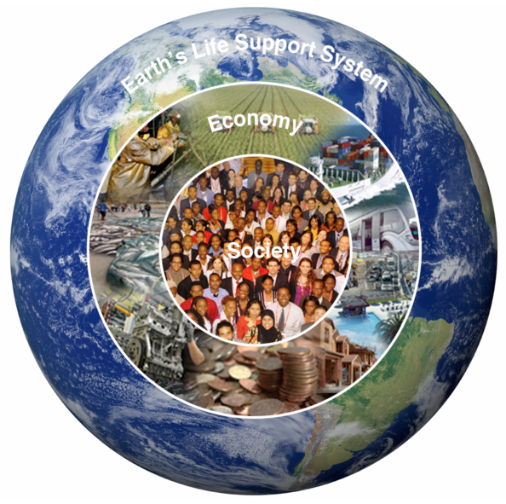
Homo Sapiens’ Economy and Earth’s Life-Support System
Purpose of economy is to increase human wealth;
Earth and its natural wealth is basically infinite.
Smith (1776)
"Sustainable development is development that meets the needs of the present without compromising the ability of future generations to meet their own needs”.
WCED (1987)
“Sustainable Development is a development that meets the needs of the present while safeguarding Earth’s life support systems, on which the welfare of current and future generations depends.”
Griggs et al. (2013)
Our Message to Humanity: You need an economy that meets the needs of the present while safeguarding Earth’s life support systems, on which the welfare of current and future generations depends.

Slide 69
Homo Sapiens’ Economy and Earth’s Life-Support System

Slide 71
Key Points
Baseline
During the Holocene, climate and sea level were exceptionally stable
The Holocene was a “safe operating space for humanity”
Syndrome
During the last few hundred years, humanity has introduced rapid and large changes
The system is outside the “normal range” and in the dynamic transition into the Post-Holocene; we have increasing disequilibrium
Diagnosis
Easy access to seemingly unlimited energy allowed humans to accelerate flows in the Earth’s life-support system and sustain rapid population growth and increasing demands
Humans are the “Anthropogenic Cataclysmic Virus” (ACV) in the Earth’s life-support system
Prognosis
We are heading rapidly into a very different system state (thresholds; Post-Holocene)
Our knowledge is changing rapidly; there is room for surprises; Foresight is needed
Therapy
Change in the purpose of economy from growing human wealth (growth addiction) to meeting our needs while safe-guarding the life-support system

